Slide 2
Notes:
God loves you. Unconditionally. No strings attached.
In response to this gift, there are twelve things that we do individually and together as we grow as followers of Jesus, which help us to worship God, serve others, be evangelistic, and learn and care together.
None of this makes God love you any more - but they may help you realise how deeply you are loved by God.

Slide 3
Notes:
God longs to take you on the journey of a lifetime.
Let's create a modern-day parable. imagine that God's a train driver.

Slide 4
Notes:
When we respond to God's love, it’s a bit like getting on the train.
This can be scary, but nothing else in life is as satisfying. Staying where you are is an option, but you miss out on so much.
What if you joined in with God’s adventure, what if you started a journey …not really sure what was going to happen or where you might end up next, with an open ticket for unlimited travel?
What’s important is deciding to get on the train, committing to the journey.
There might be specific moments that stand out, like the day you first said 'Yes!' to Jesus. That's like stepping on to the train for the first time. Or maybe you’re just thinking about starting the journey now.
But it’s also a daily commitment to keep travelling, in good times and bad.

Slide 5
Notes:
But where does the train go? What does this journey involve?
There’s a map – we call it a Methodist Way of Life.
The train goes to twelve stations.
It's good to visit them all because, each station is an opportunity to:
• encounter God,
• grow in maturity,
• step out in mission and action,
• be surprised by joy.
Each station on the way represents a different spiritual practice we might do, a different way we can encounter God. Some stations will be familiar to you, but some might be new.

Slide 6
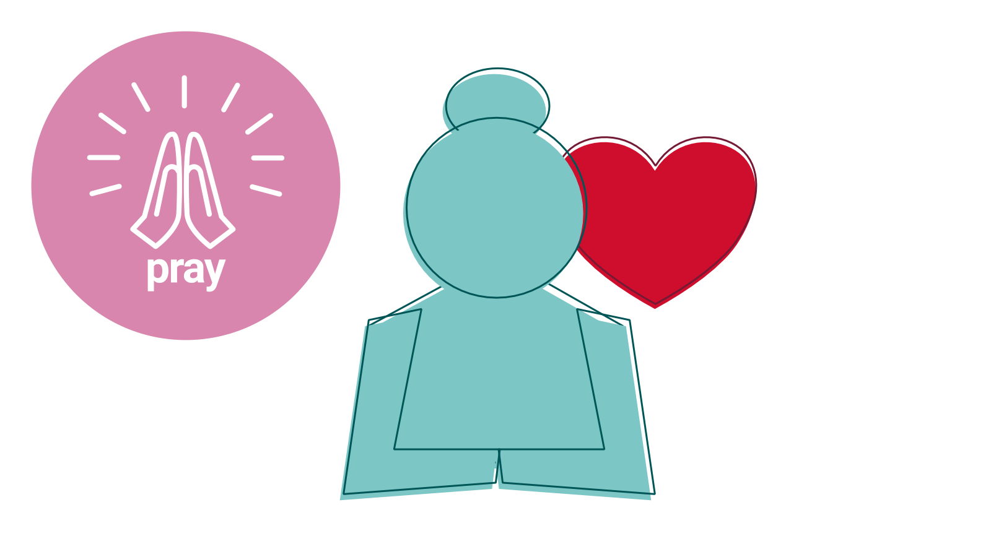
Notes:
God loves spending time with you. Don't overcomplicate it. God's there and is a perfect companion.
Praying is a bit like breathing: like the air around you, every second of every day you are in God’s presence.
It is also good to make a space in your day when you focus on praying. You can share what’s on your heart, pray for others, and listen to God.

Slide 7
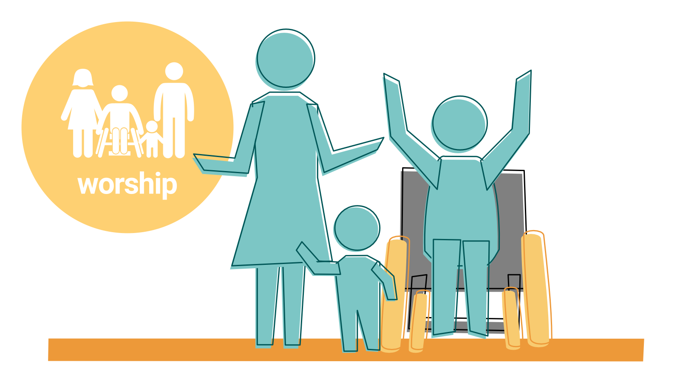
Notes:
God gives unbounded love and grace to us, and worship is one way of responding and celebrating this. As a consequence, we are transformed by the grace and power of God, receiving forgiveness and mercy.
Worshipping God with others also helps to knit us into a faith community, with mission as “the natural, even inevitable, consequence”
We also worship God through our everyday activities – at work, at home, and wherever we live our daily life.

Slide 8
Notes:
We notice God in Scripture, and the world.
God is near, and findable. But not completely.
The Bible is an ancient collection of writings in different styles. The authors recorded how they experienced God at work in their lives. It helps us to understand and experience God for ourselves. But we can never fully understand God; that’s why it’s called ‘faith’.
It is also possible to notice God in science and nature, in family, in work, in books, in films, in leisure, in our local community and in world events.

Slide 9
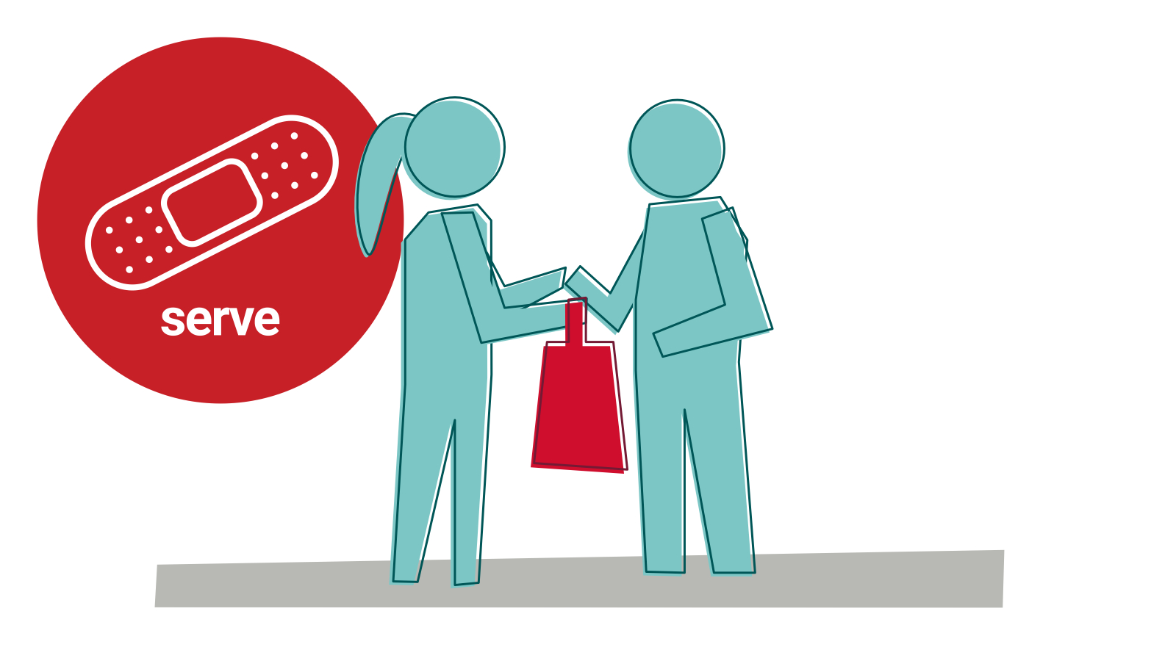
Notes:
We will help people in our communities and beyond
From the very beginning, God created us to need each other. When we help someone, or receive help from someone, God invites us to see God in one another.
All people have the ability to give and receive. And just because someone has a need, it doesn’t make them powerless to also serve and give kindness to themselves or others.
God invites us to see God in one another.

Slide 10
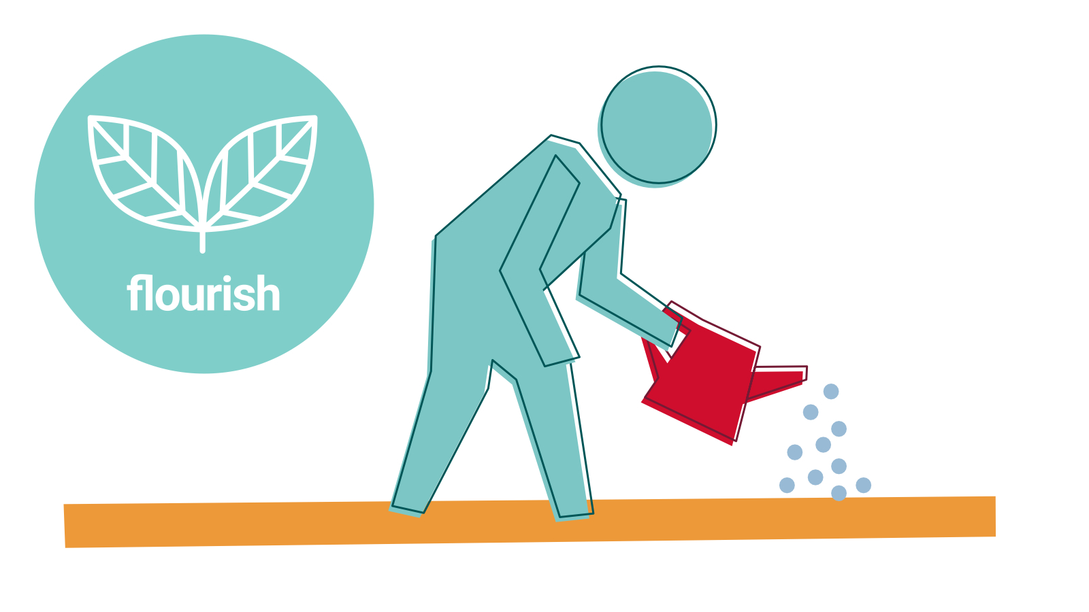
Notes:
We care for creation and all God's gifts
The universe is an expression of God’s loving, creative nature.
We are currently in a climate emergency requiring urgent action, but the good news is that by learning about God’s love for creation and our place within it, we can learn to take care of the world we live in.

Slide 11
Notes:
We challenge injustice
God is a liberator. God always takes the side of people experiencing poverty and injustice and we are called to do the same.
We long for God’s justice in the world. Around the globe and in their own local communities, Methodists are working for justice through responding to needs and campaigning for change.
Challenging injustice is never easy – it is rare for a challenge to be welcome. This can be something you do as an individual, but it can be better to work together as a small group or a congregation.

Slide 12
Notes:
We tell of the love of God
Your story matters.
It's natural to want to pass on good news – a new baby or grandchild, a new job, passing an exam, getting on a team. Evangelism is about passing on the good news of Jesus’ love for you, and it flows out of our excitement about what we have discovered.
You've got a story to share about how God's love has affected you, a story that might make all the difference to another person.

Slide 13
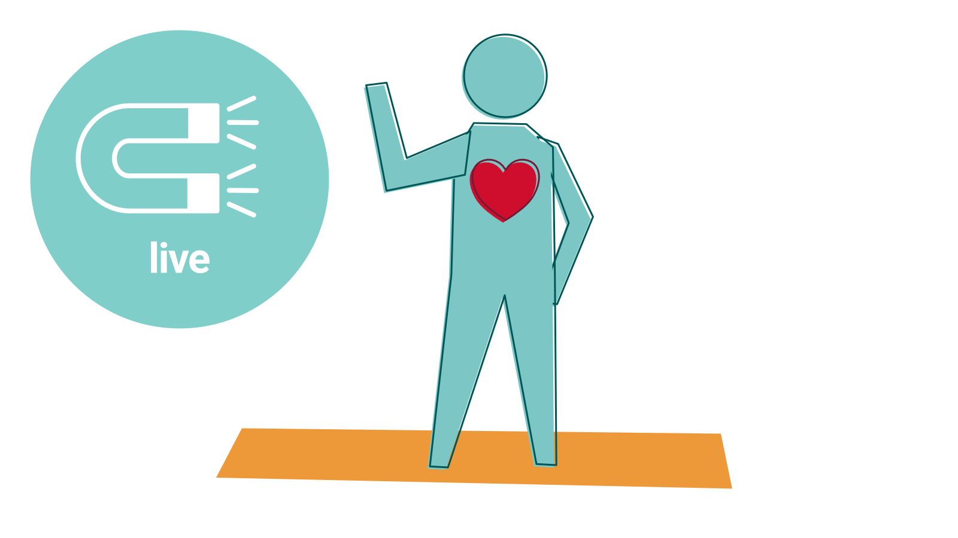
Notes:
We live in a way that draws people to Jesus
You be you.
We are formed by the people and culture around us. But we are all also made in God's image, so let that shine out.
You have great power to influence and affect other people by the way you live your life.
The best way is to live authentically as a whole self; the self who God made you to be. In this way we worship God in our day-to-day lives at work, at home, and out and about.

Slide 14
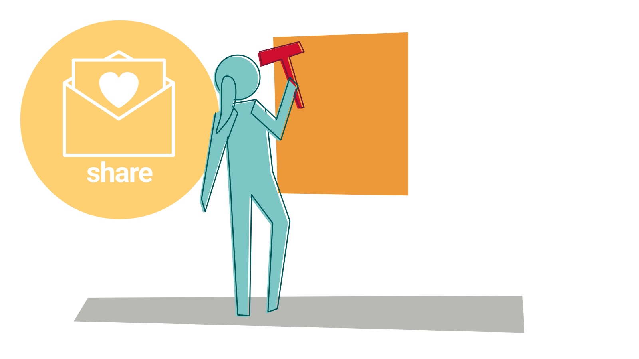
Notes:
We share our faith
You get to partner with God.
God involves us in the task of bringing love and restoration.
There are lots of ways to share your faith. Sometimes it's fun to join with other people and put on a community event that has a presentation of the good news and space for conversation. Or you can be creative, using crafts to let people know that God loves them.

Slide 15
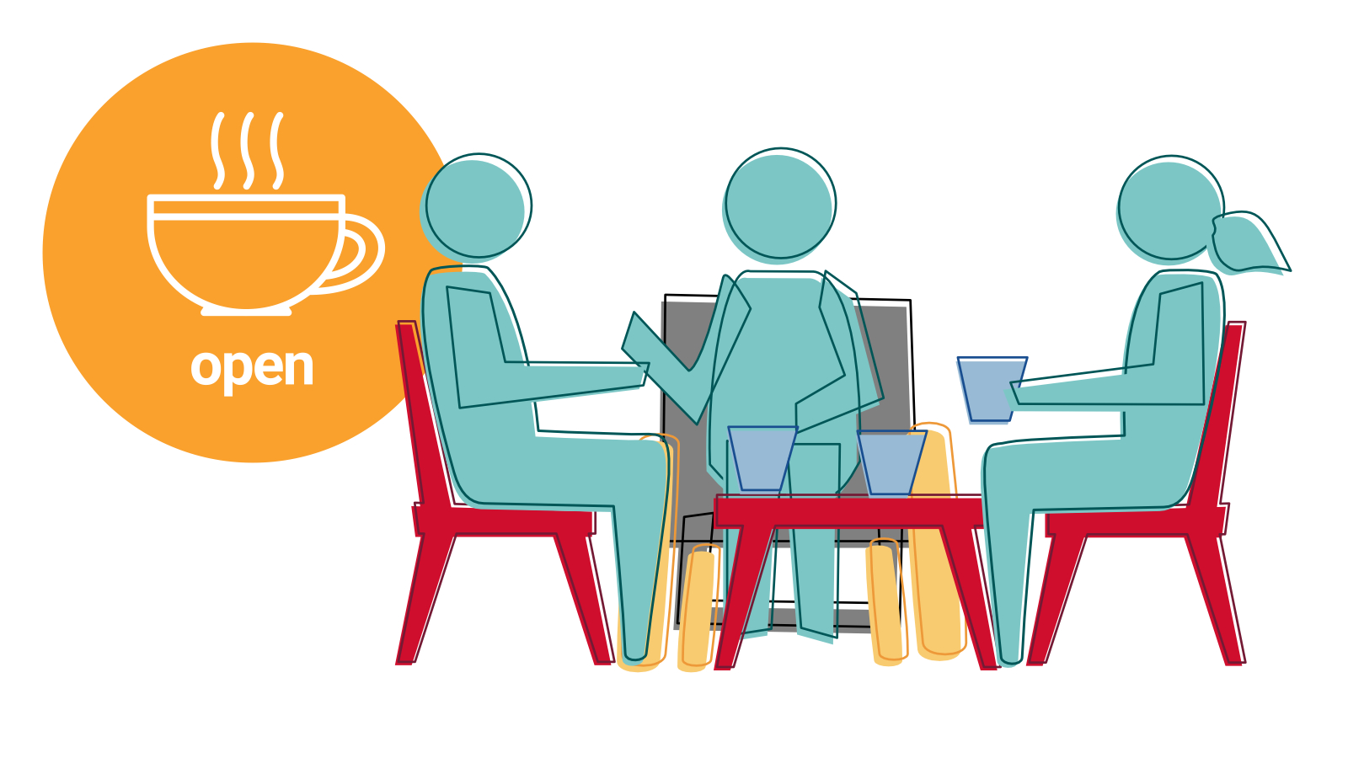
Notes:
We practise hospitality and generosity
God always gives a warm welcome. We meet God in relationship with people. It's good to be open-hearted and open-minded, generous and hospitable.
Hospitality is an attitude of openness to others, to learning about them and from them, to widening our understanding and perhaps being changed by the encounter. It’s not always us being hospitable to someone else – it’s a blessing to receive hospitality too.
Generosity is also a basic Christian practice. As we have freely received, so we are to give freely. Though this may involve sacrifice, it is rarely right to give in such a way that we are unable to care for ourselves and our dependents.
It’s important to be open to receiving hospitality and generosity from others because, if we only give, we place ourselves in positions of power over others. God is present with and in all people, in all circumstances, and waits to be discovered.
Our task is to listen, recognise and be transformed by God at the margins.

Slide 16
Notes:
We learn more about our faith
You can become like Jesus. You are not stuck where you are.
Jesus calls us to be disciples, which is like being an apprentice. We need to learn, grow, change, and be surprised by God.
For some people this might be formal theological education, but we also learn through our day-to-day lives and encounters with other people.
There are lots of things that can block learning. We might be over-nostalgic and sceptical of the unknown. Or get stuck in an ideology that limits curiosity. Or just get distracted.
But, by definition, disciples are learners, so stay open-minded!

Slide 17
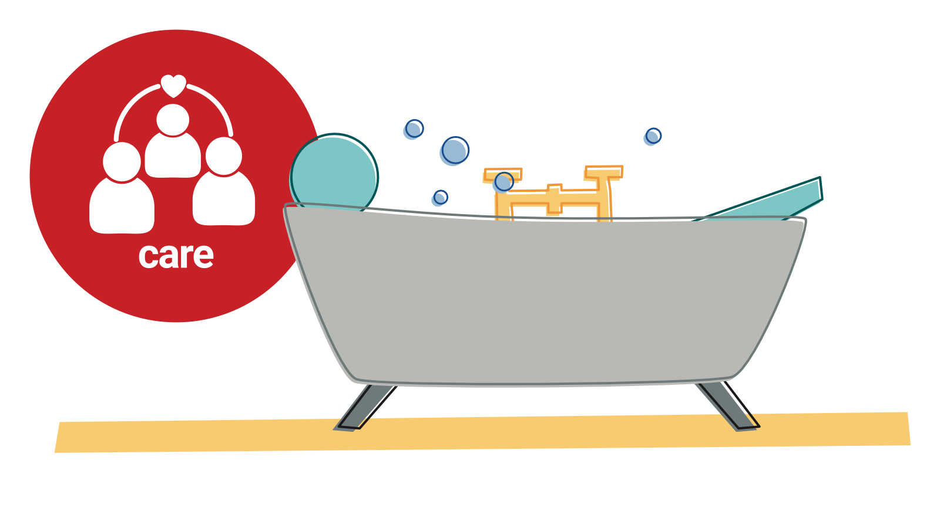
Notes:
We care for ourselves and those around us
It's all about love. Love for God, other people and yourself is what matters most.
Jesus made it clear: his followers should love their neighbour as themselves. Loving each other is at the centre of our spiritual journey. And how we love ourselves and each other reflects the way we believe Jesus loves us.
Take care of yourself, rest when you are tired, enjoy the things you like doing, get a good balance of work and leisure. This will help you to care for other people.

Slide 18
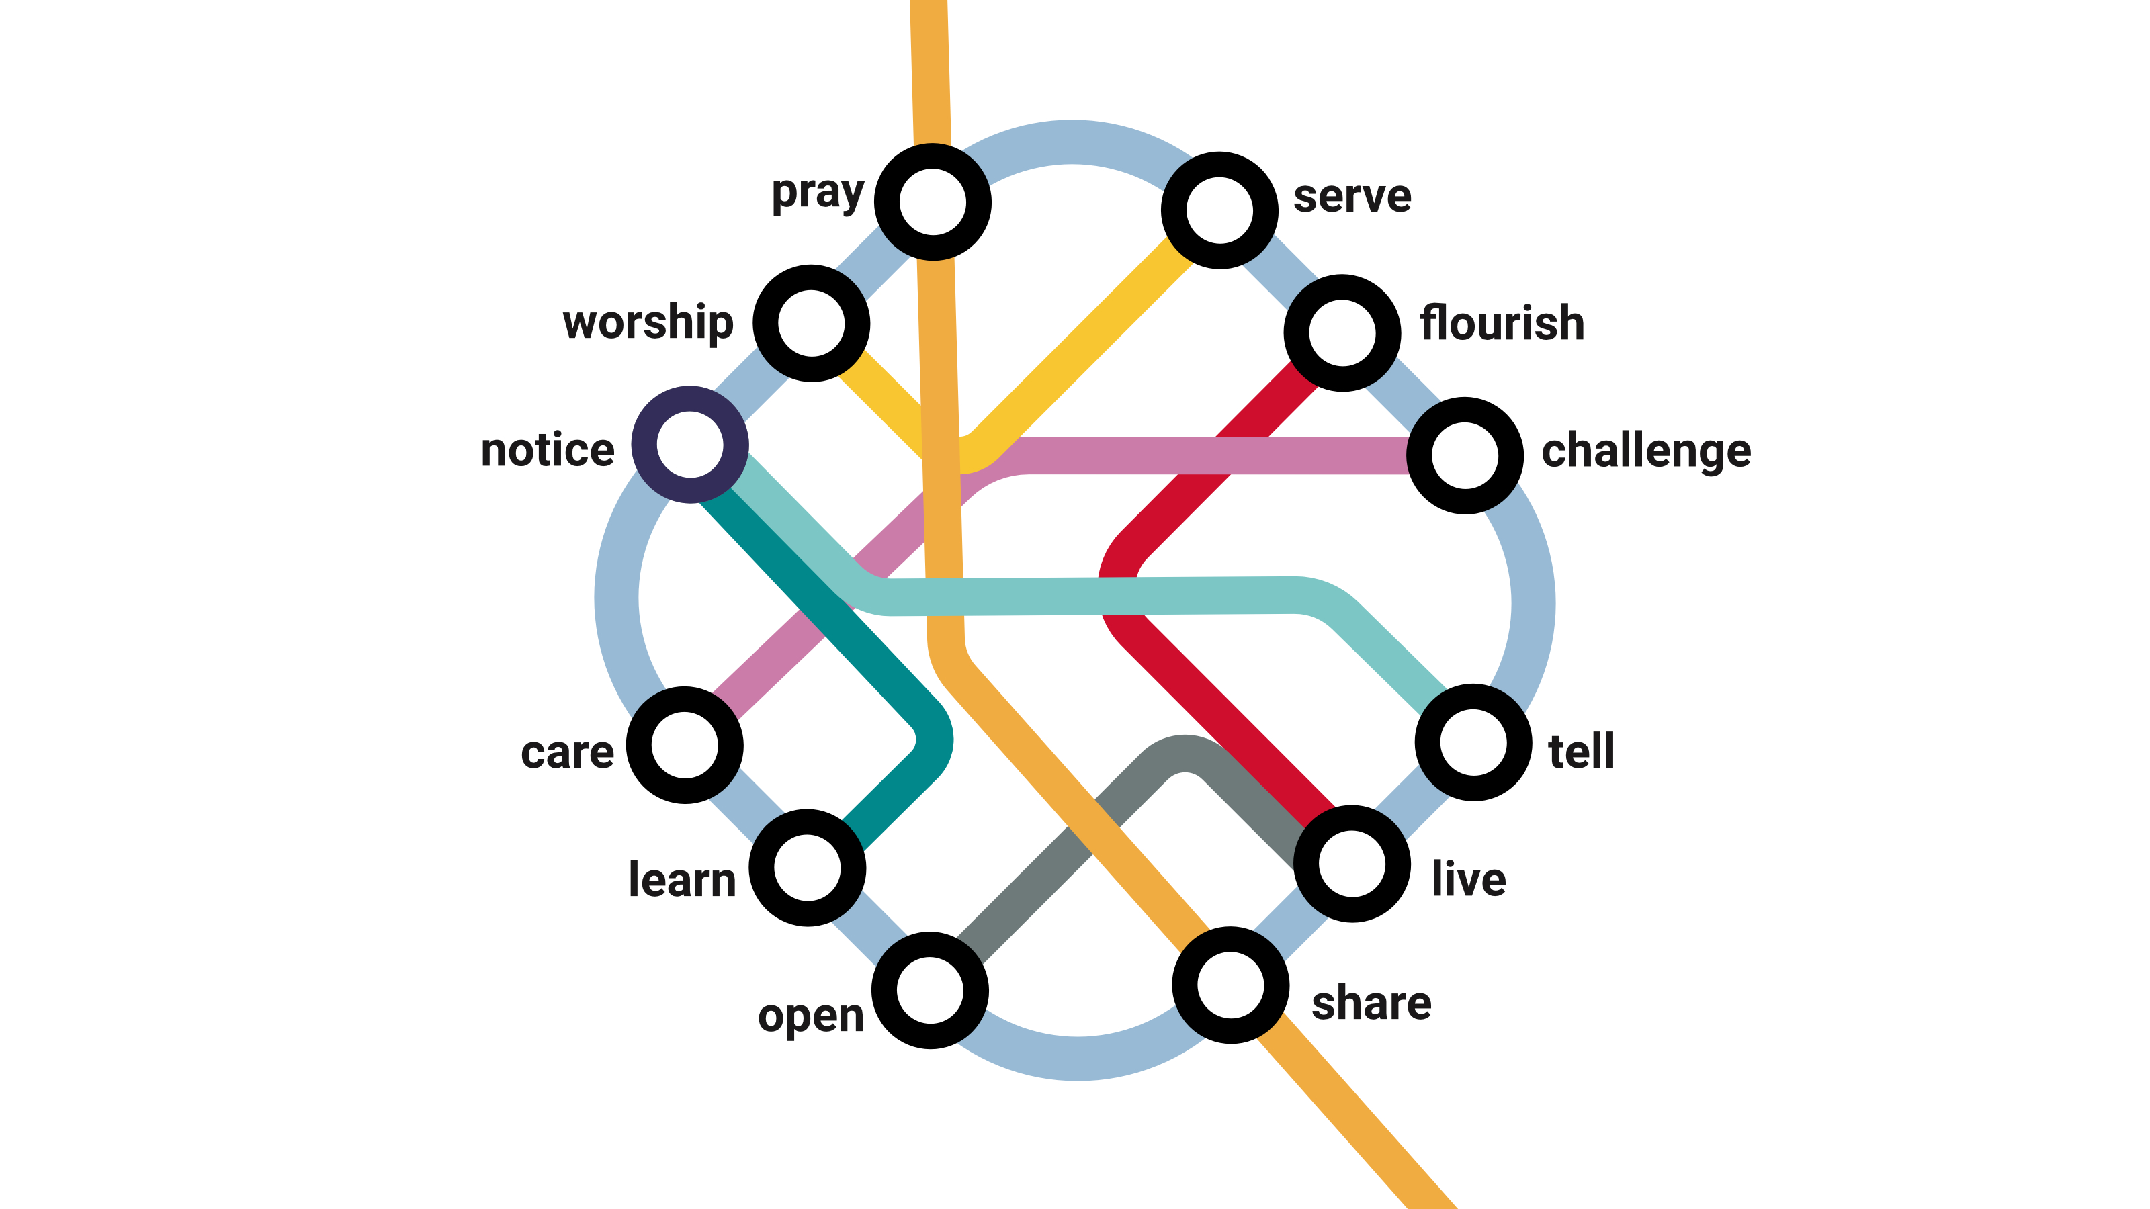
Notes:
Which is your home station
- the one that's most comfy and familiar?
We are all different and have different gifts. Spend lots of time at your home station!
Are there any stations that scare you a bit?
The good news is that we don't travel alone. God is with you, and friends on the journey too
All of the twelve stations are interconnected.
For example, prayer leads into care for people, and vice versa. Justice and Evangelism are gospel partners.
Which connections inspire you the most?

Slide 19
Notes:
We learn together between stations as we share stories and reflect on our encounters with God. Some people reflect in group conversation. Others prefer to journal.
The Holy Spirit shapes and develops you, and you can become more like Jesus.

Slide 20
Notes:
Now, if you are involved in leading other disciples in any way, there are three more steps.
As church leaders we’re on our own discipleship journeys.
But we also play a role as companions to others.
We journey alongside people who are exploring the network, particularly if they’re still deciding whether to get on the train.
We might be a tour guide, helping someone explore a different part of a familiar station
or encouraging them to leave their familiar home station, so that they experience God in a new and different way.
Perhaps we’re even sales people, telling people about the great features of a station they haven’t been to yet.

Slide 21
Notes:
Of course, we can’t direct people to stations that don’t exist.
So we might need to ‘construct stations’ or build new infrastructure, ensuring that our churches and circuits have opportunities for people to take part in all these activities.
That might mean starting a new prayer group, or helping someone who is passionate about injustice to join up with a Circuit initiative.
It might mean partnering with other churches, and organisations with particular expertise.

Slide 22
Notes:
The discipleship journey is an exciting one, and deeply fulfilling.
So we don’t want to limit the journey to people who are already travelling.
Each station in the network is an opportunity for new people to start their own journey.
For one person, that might be sensing something spiritual in nature.
For another, it might be wrestling with questions about evil in the world.
We want to ensure the stations (our activities and practices) are accessible to new people as well as experienced travellers.
As leaders, we need to be able to support people in taking those first steps into the network, and exploring the journey God is taking them on.

Slide 23
Notes:
So that's discipleship, expressed as a parable of a train journey.
But what does it look life in real life?
Maybe like this – a group of people who gather in a chapel building, have Bible studies, coffee mornings and take part in protests against injustice.

Slide 24
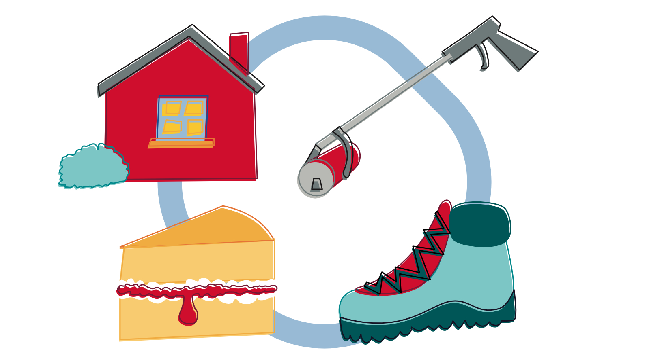
Notes:
Maybe in a rural context people gather in each other's homes, bake tasty cakes for the community, take part in walk-and-talk hikes, and join in litter picking.

Slide 25
Notes:
It works in a digital context too. You can worship online, learn from podcasts (including our very own Hope and Anchor!), be nice on social media, and take part in online petitions.

Slide 26
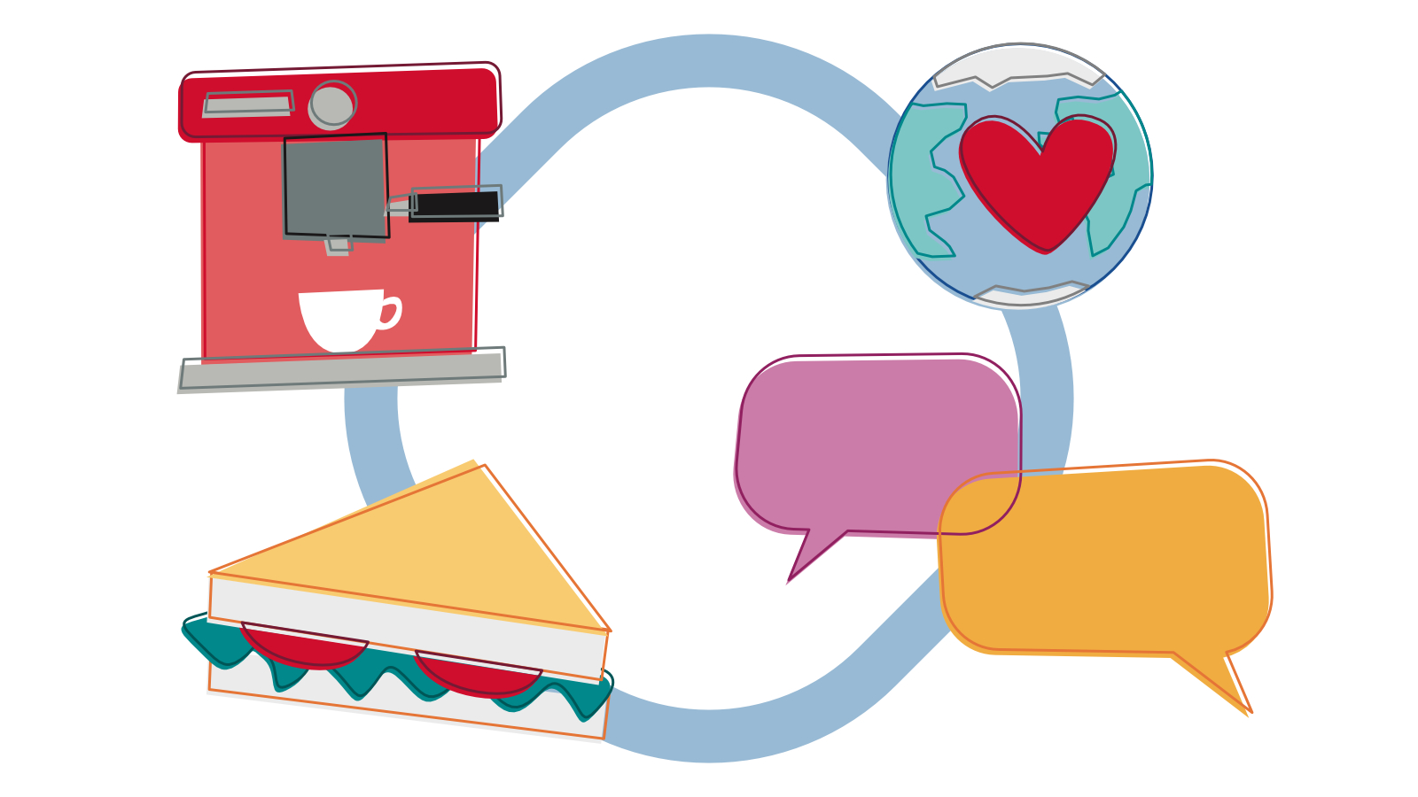
Notes:
It also fits a pioneering context too. You might meet with people in a café, share food, tell stories and share ideas for caring for the enviroment.

