Slide 1
Notes:
A Methodist Way of Life

Slide 2
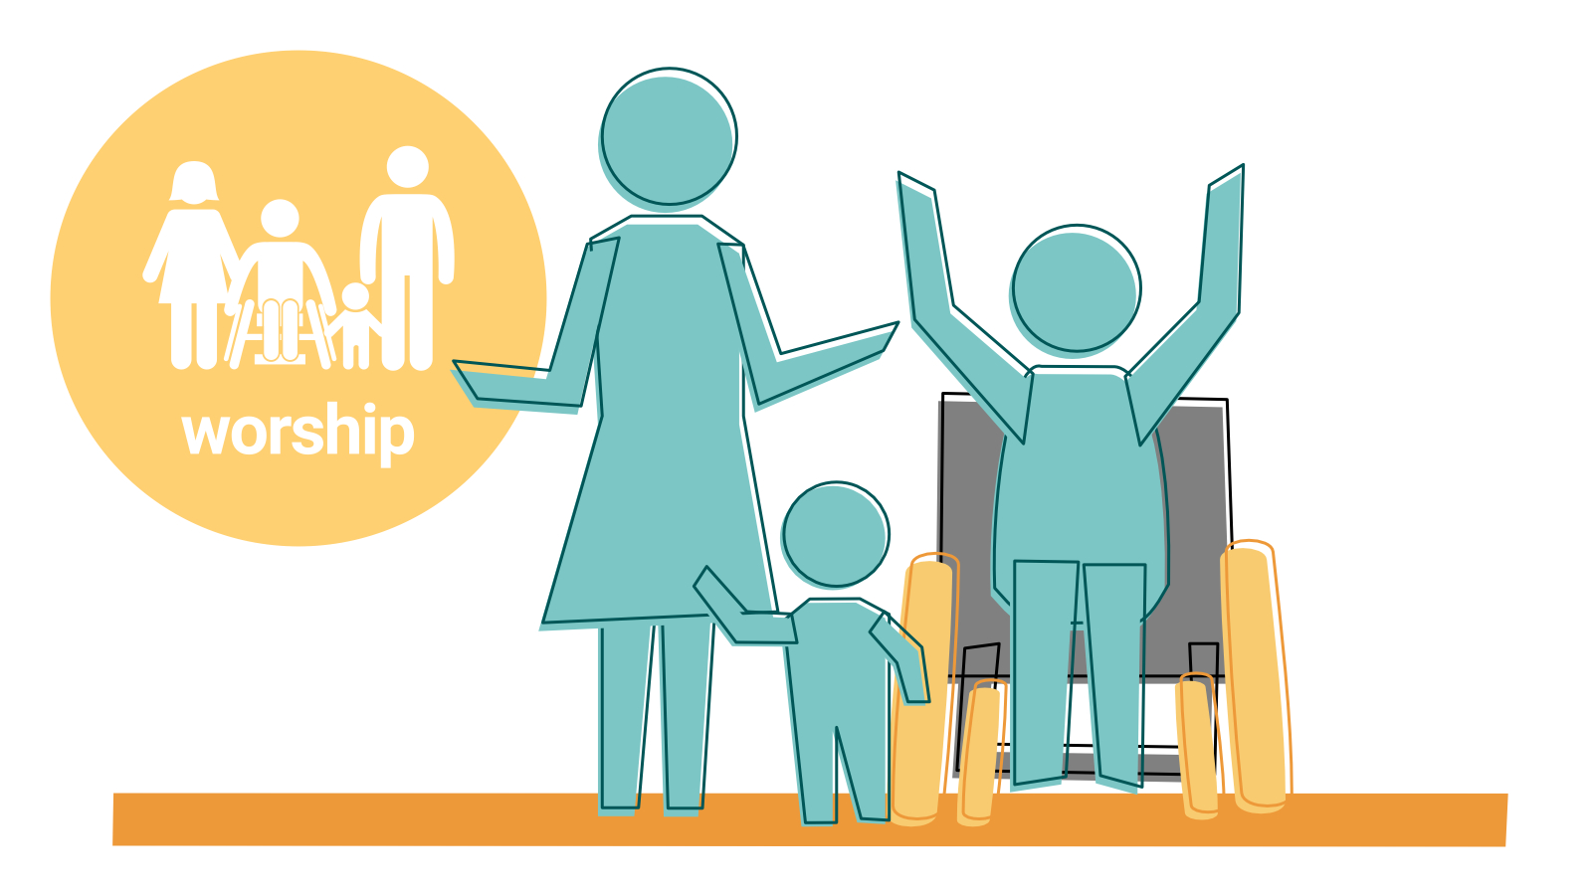
Notes:
Session: Worship (see ‘key themes’)
We worship with others regularly. God wants to refresh you. Worshipping with others helps to knit us into a faith community.

Slide 3
Notes:
Session: Worship (see ‘background reflection’)
Worship was at the centre of the practice of the Early Church but it may have looked quite different to our worship services today. Worship was a combination of time at the temple and domestic gatherings arranged around a celebration of the Last Supper. Luke tells us in Acts: “Day by day, as they spent much time together in the temple, they broke bread at home and ate their food with glad and generous hearts, praising God” (Acts 2:46). How does this compare or differ to your worship today?

