Slide 1
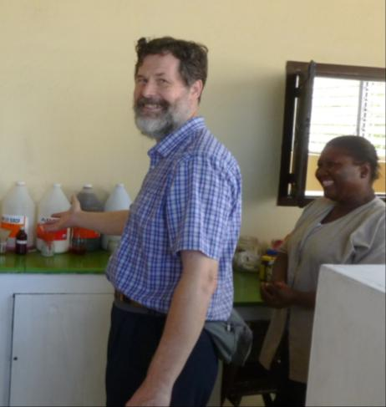
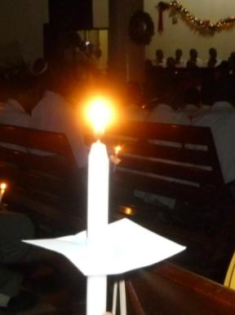
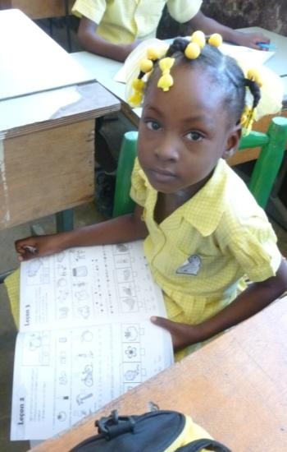
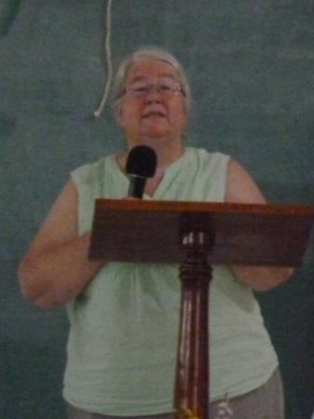
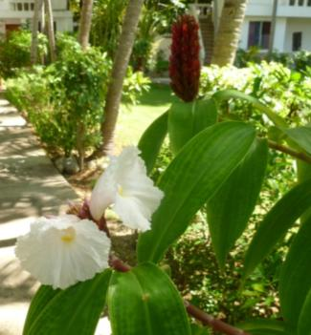
Advent Hope
2015

Slide 2
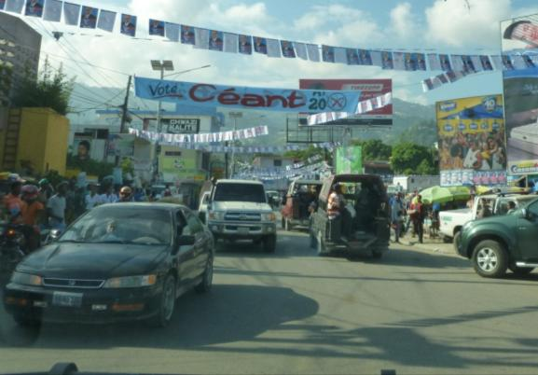
Haiti is hoping for a new President
We have the final round of elections on 27th December

Slide 3
Campaign slogans are everywhere

Slide 4
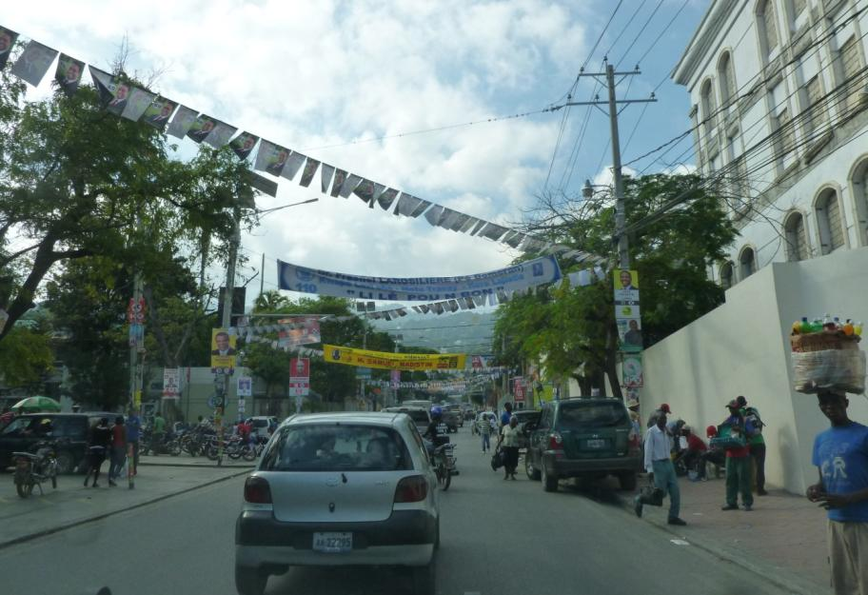
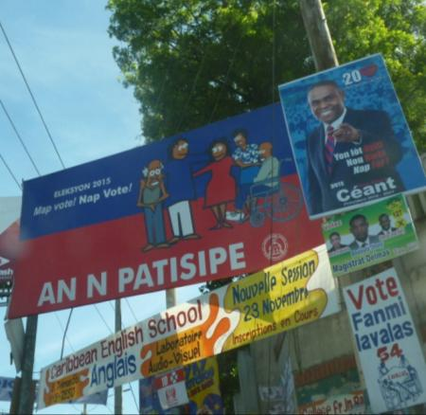
People are encouraged to vote
All can participate
My vote, our vote!

Slide 5
But what sort of leader do we want?

Slide 6
Over 2000 years ago the Jewish people were hoping for a leader to save them

Slide 7
Jesus, the Son of God, came as our Saviour, God with us, Emmanuel.

Slide 8
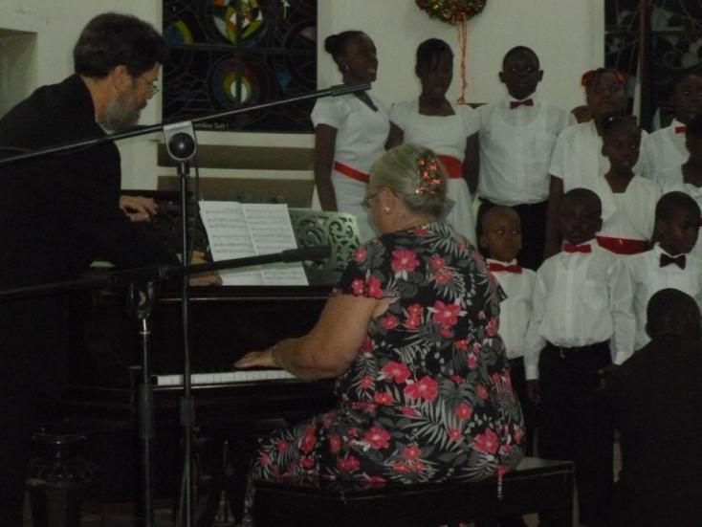
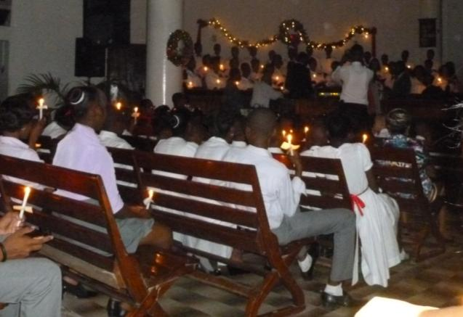
We celebrate his coming, seek him daily and look for his return
Christmas Eve, last year: Service at
Port au Prince Church

Slide 9
Last year on Christmas Day we joined the Church feeding children

Slide 10
From La Saline near the docks

Slide 11
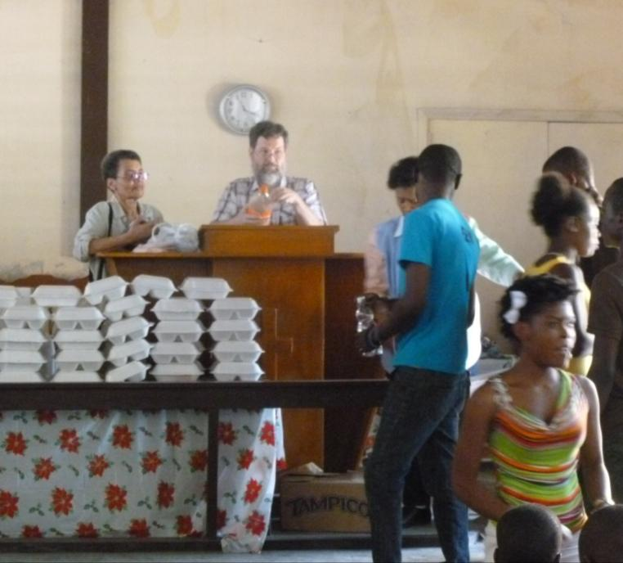
Sharon led devotions and John gave a health talk on clean water

Slide 12
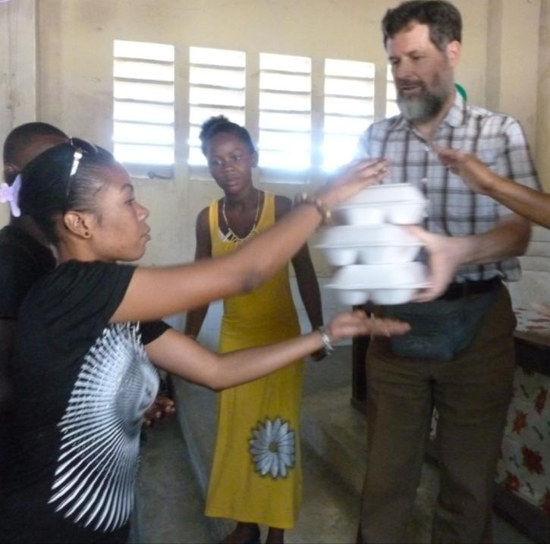
Before the food was distributed

Slide 13
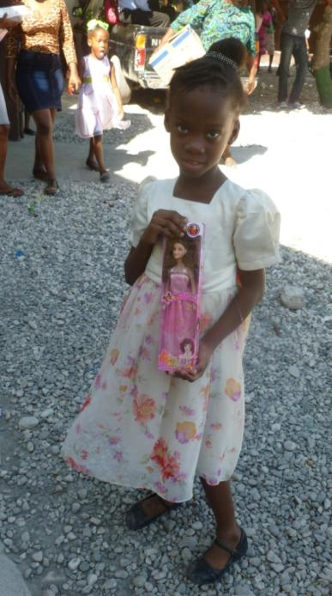
And presents given

Slide 14
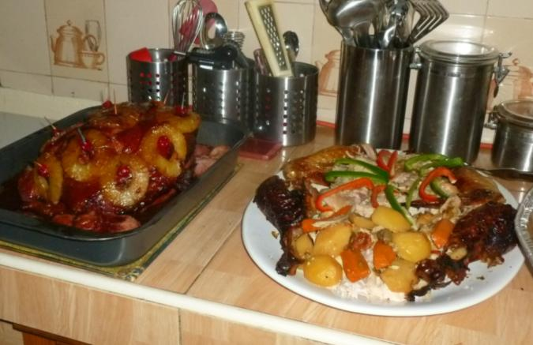
We were invited to a friend’s home for a late lunch

Slide 15
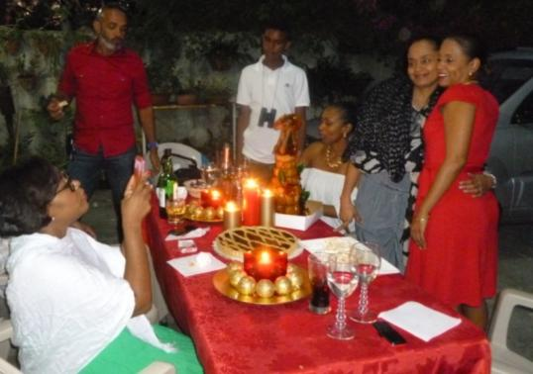
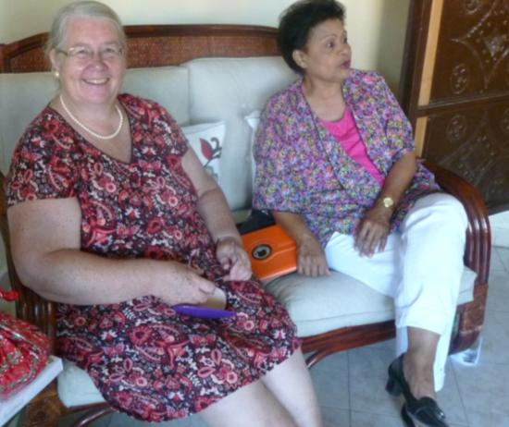
And enjoyed their hospitality

Slide 16
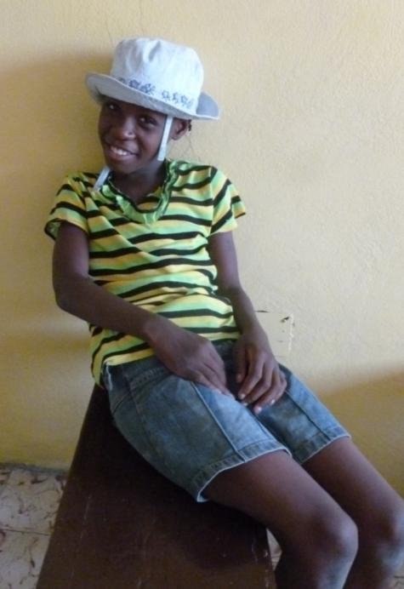
Hope shines in the eyes of children everywhere, especially at Christmas

Slide 17
Here, hope fulfilled, is a stocked pharmacy at the clinic

Slide 18
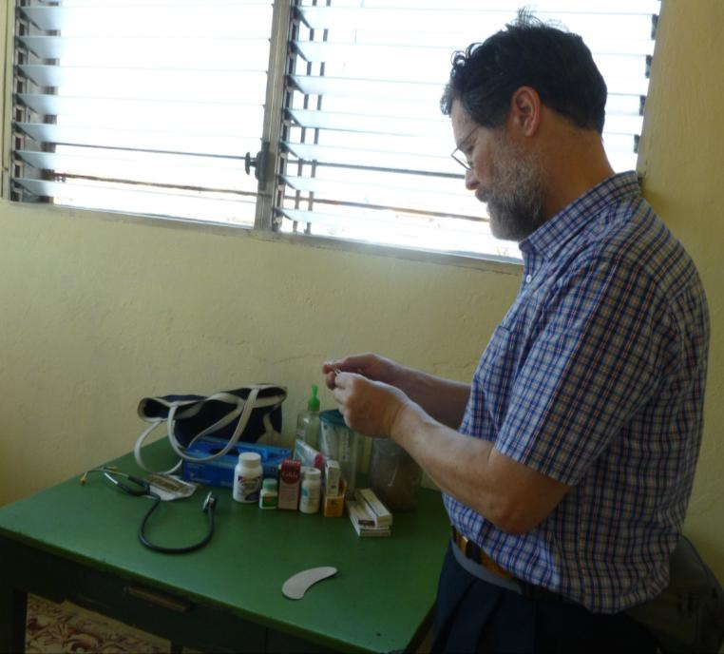
Healing in the name of Jesus

Slide 19
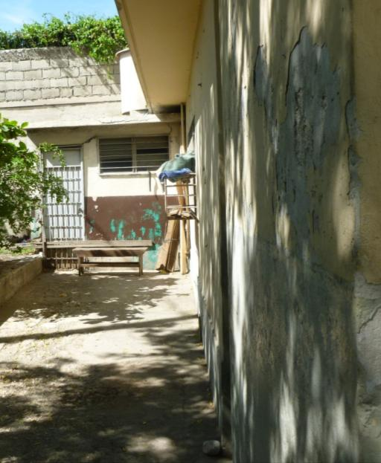
The clinic has a new roof, but other repairs are still needed.

Slide 20
In Haiti, hope fulfilled, is Education in the name of Christ

Slide 21
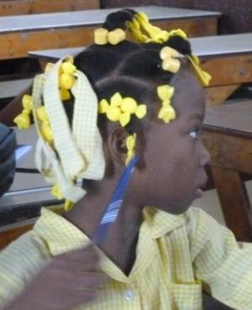
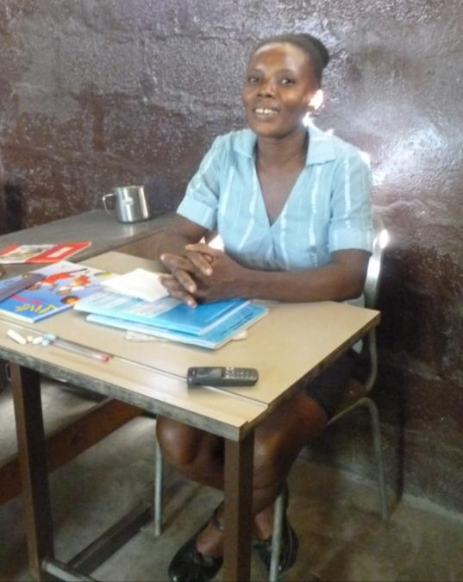
Resources are basic
But teachers are very dedicated

Slide 22
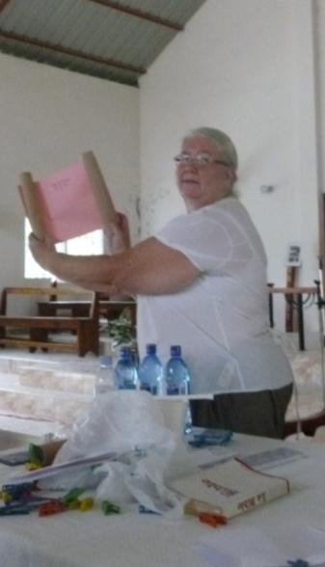
Hope fulfilled, is 300 Local Preachers receiving teaching
Sunday School
Teacher Training too
And sitting their New Testament exam

Slide 23
Please pray
For peace and stability during the elections
For Local Preachers sitting further exams, that their increased learning will strengthen the Church
For the daily work of Clinics and Schools, healing and teaching
For the Work of the Church and its 14 ministers
For the Agriculture and Micro-finance projects organised by the Church, and all engaged in the Mission of God.
For John and Sharon Harbottle as they serve in Haiti

Slide 24
May Jesus, the Hope of the World, be with you this Advent
Rev Yachelle Watson and her father

Slide 25
Happy Christmas from Haiti

Slide 26
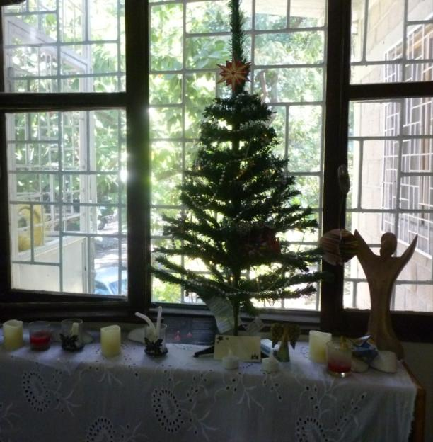
With love from Sharon and John

