Slide 1
Welcome
Creating Safer Space
Foundation Module
2020 Edition

Slide 2
Trainers:
Name
Role
Name
Role

Slide 3







Mobile phones – silent or off
Toilets
Fire exits
Refreshment break
Timekeeping
Question park
Attendance sheet

Slide 4

Opening devotions

Slide 5
CSS Foundation Module 2020
This training is a basic starting point or a refresher course. Whatever your role, it will help you to understand safeguarding in the Methodist Church and our collective responsibility for creating safer spaces for all.

Slide 6
Aims and objectives
to appreciate safeguarding is everyone’s responsibility and fundamental to the culture of a flourishing Church
to have a better understanding of good safeguarding practice within the Methodist Church to create a safer space for all
to promote awareness and extend an inclusive welcome to those who have experienced abuse
to recognise, respond, record and refer relevant concerns about the safety and welfare of a child or adult, and recognise blocks to good practice
to learn from evidence from the Methodist Past Case Review (2015-17) and note the current national context, eg the Independent Inquiry into Child Sexual Abuse (IICSA)

Slide 7
While we are together, we will:
listen without interrupting
respect the feelings, experiences and views of other people
listen to different views and question in a constructive
way that enables learning
respect confidentiality unless it puts others at risk
take responsibility for our own learning
and share as well as receive learning
be aware of the potential impact of
the subject on ourselves and others.

Slide 8
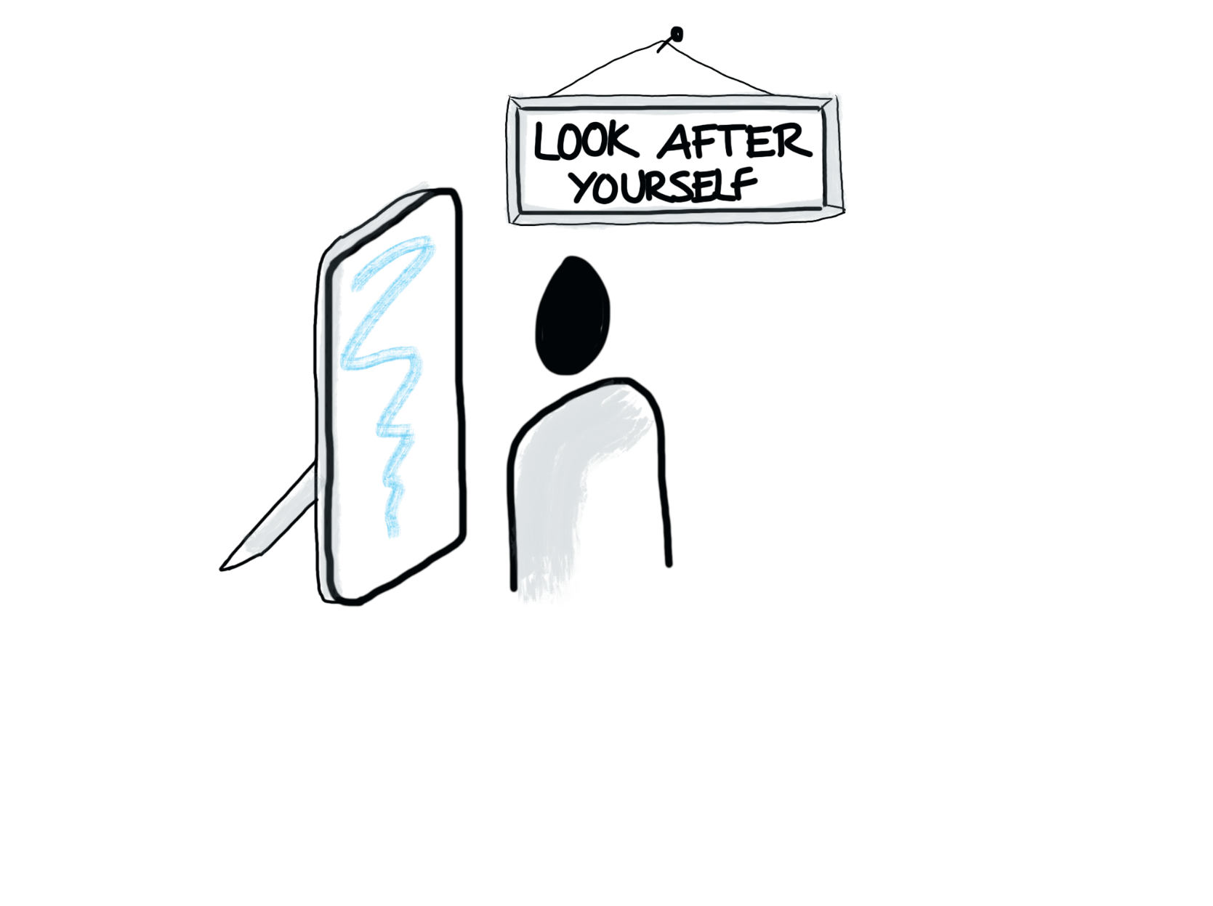

Slide 9
Creating Safer Space:
Foundation Module – 2020 Edition
Name: Date:

Slide 10






What makes the
church unique?
Children and
Young People
VulnerableAdults
Church leaders,
staff and volunteers
Those who may be a risk to others
Those who have
experienced abuse

Slide 11



Children and
Young People
Anyone who has not
yet reached 18 years or
16 years in Scotland.

Slide 12
Children and
Young People
Good Practice: How we safeguard
promote a safeguarding culture
understand and follow policy and procedures
be vigilant to risk and protect children and young people from harm and promote their welfare
take action if we are concerned
make sure church premises are safe
check we know who to ask for guidance about safeguarding when we are unsure about what to do.

Slide 13
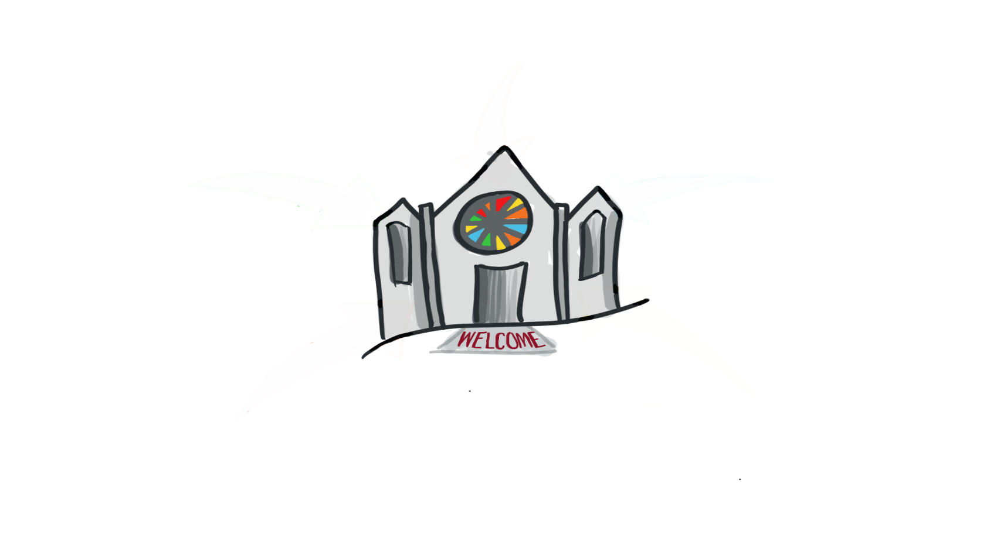

Vulnerable Adults
Any adult aged 18+ (16+ in Scotland) who, due to disability, mental function, age or illness or traumatic circumstances, may not be able to take care or protect themselves against the risk of significant harm, abuse, bullying, harassment, mistreatment or exploitation.

Slide 14

What can make an adult vulnerable to harm?
Age-related frailty
Physical illness
A learning disability
Mental ill
health (including dementia), chronic or acute
A sensory or physical disability or impairment
Addiction to alcohol, or drugs
A permanent or temporary reduction in physical, mental or emotional capacity brought about by life events, eg bereavement or previous abuse of trauma
Activity

Slide 15

Vulnerable
Adults
Good Practice: How we safeguard
Assume the adult has mental capacity and the right to make their own choices – even ones that we may disagree with
Ensure they know where to get appropriate help and support if needed
Follow safeguarding policy and procedures
Ensure the premises are safe
Know who to ask for guidance if you are not sure

Slide 16


Labels such as ‘victim’
and ‘survivor’ may be
unhelpful
Abuse includes:
any form of abuse suffered
abuse suffered as a child or an adult
one-off or prolonged abuse
Those who have
experienced abuse

Slide 17

Those who have
experienced abuse
Good Practice: How we safeguard
We ensure the Church is a safe space, where those who wish to disclose abuse can feel supported to do so.
We create a space where those who have experienced abuse feel welcomed.
We hold in mind the power and impact that our words and actions can have on those who have experienced abuse.
We follow safeguarding policy and procedures.
We ensure the premises are safe.
We know who to ask for guidance if we are not sure.

Slide 18

Those who may be a risk include people who:
are known to have abused
demonstrate concerning behaviour
have previous convictions
are under investigation.
All are welcome in
the Methodist Church, but that welcome must be extended safely.
Those who may be a risk to others

Slide 19

Those who may be a risk to others
The welcome
is for those who want to repent and move on
Good Practice: How we safeguard
Safeguarding contracts
Continued care and vigilance
Follow safeguarding policy and procedures
Ensure the premises are safe
Know who to ask for guidance when you are not sure

Slide 20
Church leaders,
staff and volunteers
The Church values all those who give generously of their time and energy in roles that are both paid and voluntary.
Thank you.

Slide 21


Church leaders, staff and volunteers…
should be aware of how they use their position to influence others as their opinions have weight and significance.
abuse, bully, manipulate or denigrate
Show kindness, heal, sustain others and harness their strengths
Notes:
Power is exercised and experienced in many ways.
Church leaders, staff and volunteers should beware of the potential of using their position to influence others as their opinions when proffered have weight and significance.
These roles have differing levels of power and authority over others. This power needs to be used to sustain others and harness their strengths, and not to abuse, bully, manipulate or denigrate.

Slide 22


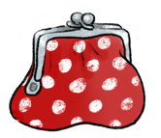
Church leaders,
staff and volunteers
Keeping yourself safe…
Sometimes good intentions can leave you vulnerable to allegations…
“I only have Mrs Smith’s bank card and PIN number because I am helping her sort out her bills since her operation. She would be stuck without me”
pastoral visitor
Notes:
Image by <a href="https://pixabay.com/users/e-gabi-293404/?utm_source=link-attribution&amp;utm_medium=referral&amp;utm_campaign=image&amp;utm_content=367975">e-gabi</a> from <a href="https://pixabay.com/?utm_source=link-attribution&amp;utm_medium=referral&amp;utm_campaign=image&amp;utm_content=367975">Pixabay</a>

Slide 23
Church leaders,
staff and volunteers
Good Practice: We safeguard through
Safer Recruitment
Ongoing vigilance and care
Positive working together (PWT)
Lay Employment Advisory Information
Following safeguarding policy and procedures
Ensuring church premises are safe
Knowing who to ask for guidance when we are not sure

Slide 24
We welcome
all safely
Children and
Young People
Vulnerable
Adults
Church
leaders, staff
and volunteers
Those who may be a risk to others
Those who have
experienced abuse

Slide 25
How do we create a safer space for all?

Slide 26
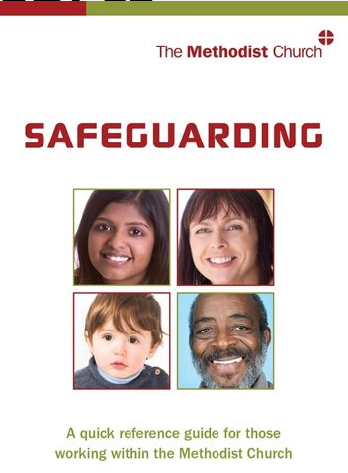


Policies… Safeguarding Policy, Procedures and Guidance for the Methodist Church in Britain | People… Your roles and responsibilities Where to seek guidance
Procedures… Registration forms / Ratios Transport Insurance Emergency planning
Premises… Health & Safety Risk Assessments Lettings

Slide 27
‘Somewhere’ and ‘Elsewhere’ Methodist Churches
What concerns you?
Activity
Notes:
27

Slide 28
Comfort Break

Slide 29

4 steps to Good Practice:
Respond
Record
Refer
Recognise

Slide 30
R ecognising types of Abuse
Physical abuse
Psychological or emotional abuse
Sexual abuse
Neglect
Self-neglect
Financial abuse
Discriminatory abuse
Institutional abuse
Domestic abuse
Spiritual abuse
Online abuse
Modern slavery
Radicalisation
Child sex exploitation

Slide 31
What are the definitions, examples, signs and indicators of the different types of abuse?
Try to write something on each sheet.
R ecognising Abuse
Activity

Slide 32
R ecognise, be curious!
Something you see... Does it look right?
Something you hear... Does it sound right?
Something that troubles you... Does it feel right?

Slide 33
R ecognising barriers to disclosing abuse
Have tried to tell before, but wasn’t believed
Being unable to communicate
Being dependent upon the perpetrator
Being fearful of the consequences
Feeling ashamed / embarrassed / guilty
Fear of not being listened to / understood / taken seriously / believed
Not recognising their experience is abusive
Activity

Slide 34
R espond: what to do
Listen
Don’t promise confidentiality
If it’s not clear what is being said you can ask open questions to clarify
(TED – Tell, Explain, Describe)
Explain what happens next

Slide 35


R espond: what stops us doing it well?
As individuals?
As a Church?
What might the impact be on the person who has experienced abuse if we do not respond well?
What might the impact be on the wider community if we do not respond well?
Activity

Slide 36
R ecord: what to do
Who was involved?
What happened?
Where it happened
When it happened
Whom you referred it on to
Signed and dated

Slide 37

R efer: what to do
Contact the police or emergency services without delay on 999.
Please let your
DSO know
If the person is at immediate risk of harm
You have concerns, witness abuse or it is disclosed to you
Write everything down and tell your leader, minister or church safeguarding officer and DSO (within 24 hours)
If the person is not at
immediate risk of harm

Slide 38
Case Studies
R ecognise: what causes concern?
Respond: what do you do?
R ecord: what do you record?
Refer: who to?

Slide 39
How does it fit together?
Notes:
39

Slide 40
Review
What makes safeguarding in the Church special?
Safeguarding is everyone’s responsibility
What I need to know for my role(s) and responsibilities
Recognise
Respond
Record
Refer

Slide 41
Any unanswered questions?

Slide 42
Using your Learning Log, spend some time considering the impact of the training on your areas of responsibility
Creating Safer Space:
Foundation Module – 2020 Edition
Name: Date:

Slide 43
Closing devotions

Slide 44
Creating Safer Space
Foundation Module: 2020 Edition
Please collect your certificate of attendance.
Please place your feedback form in the tray by the door.
Thank you for giving up your time to undertake this training.

