Slide 1
Section 1
Welcome
Creating Safer Space
Foundation Module
2020 Edition (online)
Trainers:
Names
Names
Pastoral Support:

Slide 2

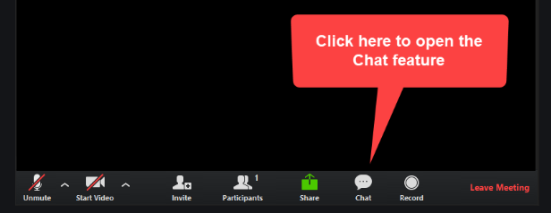
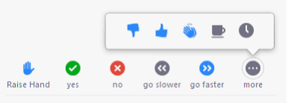
Section 1
Communicating:
Notes:
Image by <a href="https://pixabay.com/photos/?utm_source=link-attribution&amp;utm_medium=referral&amp;utm_campaign=image&amp;utm_content=371226">Free-Photos</a> from <a href="https://pixabay.com/?utm_source=link-attribution&amp;utm_medium=referral&amp;utm_campaign=image&amp;utm_content=371226">Pixabay</a>

Slide 3
Section 1
Course Overview:
Part 1: Pre-course (30 minutes)
Browse Safeguarding handbook
Part 2: Facilitated learning (2.5 hrs)
Learning log
Part 3: Ongoing learning
Find the Policies you need!
Notes:
Image by <a href="https://pixabay.com/photos/?utm_source=link-attribution&amp;utm_medium=referral&amp;utm_campaign=image&amp;utm_content=371226">Free-Photos</a> from <a href="https://pixabay.com/?utm_source=link-attribution&amp;utm_medium=referral&amp;utm_campaign=image&amp;utm_content=371226">Pixabay</a>

Slide 4

Section 1
Looking after each other:
Respect the feelings, experiences and views of others
Listen to different views and question in a constructive way
Respect confidentiality unless it puts others at risk
Take responsibility for your own learning
Be aware of the potential impact of the subject on ourselves and others
Notes:
Image by <a href="https://pixabay.com/photos/?utm_source=link-attribution&amp;utm_medium=referral&amp;utm_campaign=image&amp;utm_content=371226">Free-Photos</a> from <a href="https://pixabay.com/?utm_source=link-attribution&amp;utm_medium=referral&amp;utm_campaign=image&amp;utm_content=371226">Pixabay</a>

Slide 5
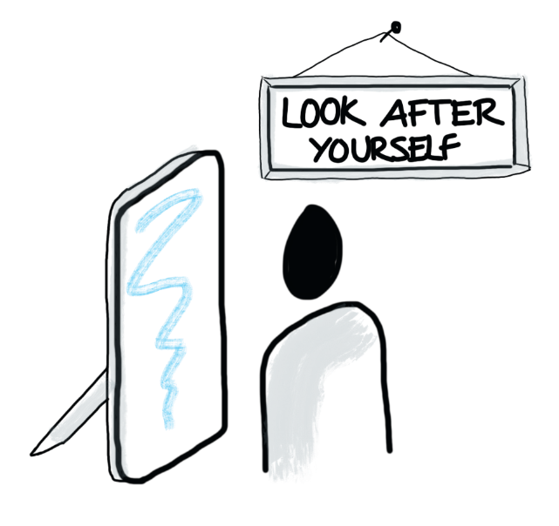
Section 1
Pastoral support:

Slide 6

Section 1
Devotions:
“There is nothing in all creation that will ever be able to separate us from the love of God which is ours through Christ Jesus our Lord.”
Romans 8:39
(Good News Version)
Opening devotions
Image by Benji Spence

Slide 7



Introduce yourself to your breakout group
Say a little about your role in the church
What questions are you bringing to the training?
Nominate a spokesperson to
summarise the questions and
feedback to the group

Slide 8






Section 2
Section 2
Children and Young People
Church leaders,
staff and volunteers
Vulnerable Adults
What makes the
church unique?
Those who have
experienced abuse
Those who may be a risk to others

Slide 9
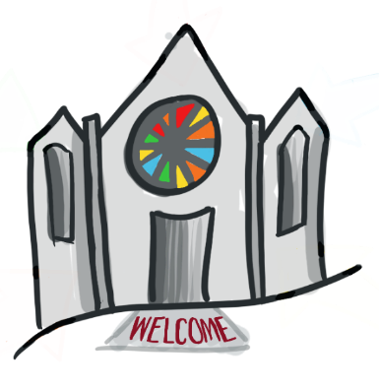

Section 2
Children and
Young People
Good Practice: How we safeguard
promote a safeguarding culture
understand and follow policy and procedures
be vigilant to risk and protect children and young people from harm and promote their welfare
take action if we are concerned
make sure church premises are safe
check we know who to ask for guidance about safeguarding when we are unsure about what to do.

Slide 10


Section 2
Vulnerable Adults
What to look for…
Something you see... Does it look right?
Something you hear... Does it sound right?
Something that troubles you... Does it feel right?

Slide 11

Section 2

Slide 12
Section 2
Vulnerable Adults
Good Practice: How we safeguard
Assume the adult has mental capacity and the right to make their own choices – even ones that we may disagree with
Ensure they know where to get appropriate help and support if needed
Follow safeguarding policy and procedures
Ensure the premises are safe
Know who to ask for guidance if you are not sure

Slide 13


Section 2
Labels such as ‘victim’
and ‘survivor’ may be
unhelpful
Abuse includes:
any form of abuse suffered
abuse suffered as a child or an adult
one-off or prolonged abuse
Those who have
experienced abuse

Slide 14


Section 2
Those who have experienced abuse
Good Practice: How we safeguard
We ensure the Church is a safe space, where those who wish to disclose abuse can feel supported to do so.
We create a space where those who have experienced abuse feel welcomed.
We hold in mind the power and impact that our words and actions can have on those who have experienced abuse.
We follow safeguarding policy and procedures.
We ensure the premises are safe.
We know who to ask for guidance if we are not sure.

Slide 15

Section 2
Those who may be a risk to others
Good Practice: How we safeguard
Safeguarding contracts
Continued care and vigilance
Follow safeguarding policy and procedures
Ensure the premises are safe
Know who to ask for guidance when you are not sure

Slide 16

Section 2
Church leaders,
staff and volunteers
The Church values all those who give generously of their time and energy in roles that are both paid and voluntary.
Thank you.

Slide 17

Section 2
Section 2
Church leaders, staff and volunteers…
should be aware of how they use their position to influence others as their opinions have weight and significance.
show kindness, heal, sustain others and harness their strengths
abuse, bully, manipulate or denigrate
Notes:
Power is exercised and experienced in many ways.
Church leaders, staff and volunteers should beware of the potential of using their position to influence others as their opinions when proffered have weight and significance.
These roles have differing levels of power and authority over others. This power needs to be used to sustain others and harness their strengths, and not to abuse, bully, manipulate or denigrate.

Slide 18


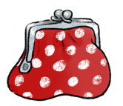
Section 2
Section 2
Church leaders, staff and
volunteers
Keeping yourself safe…
Sometimes good intentions can leave you vulnerable to allegations…
“I only have Mrs Smith’s bank card and PIN number because I am helping her sort out her bills since her operation. She would be stuck without me”
pastoral visitor
Notes:
Image by <a href="https://pixabay.com/users/e-gabi-293404/?utm_source=link-attribution&amp;utm_medium=referral&amp;utm_campaign=image&amp;utm_content=367975">e-gabi</a> from <a href="https://pixabay.com/?utm_source=link-attribution&amp;utm_medium=referral&amp;utm_campaign=image&amp;utm_content=367975">Pixabay</a>

Slide 19
Section 2
Section 2
Church leaders, staff and
volunteers
Good Practice: We safeguard through
Safer Recruitment
Ongoing vigilance and care
Positive working together (PWT)
Lay Employment Advisory Information
Following safeguarding policy and procedures
Ensuring church premises are safe
Knowing who to ask for guidance when we are not sure

Slide 20
Section 2
We welcome
all safely
Section 2

Slide 21

Section 3
Section 3
Policies…
  Safeguarding Policy, Procedures and Guidance for the Methodist Church in Britain
….Procedures
    Registration forms / Ratios
    Transport
    Insurance
    Emergency planning
Premises…
    Health & Safety
    Risk Assessments
    Lettings
…People
Your roles and responsibilities
Where to seek guidance

Slide 22



‘Somewhere’ and ‘Elsewhere’ Methodist Churches
Section 3
Does anything concern you…?
Or…
Notes:
22

Slide 23
‘Somewhere’ and ‘Elsewhere’ Methodist Churches
Section 3
What do you need to think about for your church…?
Nominate a spokesperson to
summarise the discussion and
feedback to the group
Notes:
23

Slide 24

Comfort Break
Remember to turn off your microphone and camera

Slide 25
Section 4
Section 4
4 steps to Good Practice:
Recognise
Respond
Record
Refer

Slide 26


Emotional Abuse
Sexual Abuse
Neglect
Physical Abuse

Slide 27
Section 4
R
ecognising barriers to disclosing abuse
Have tried to tell before, but wasn’t believed
Being unable to communicate
Being dependent upon the perpetrator
Being fearful of the consequences
Feeling ashamed / embarrassed / guilty
Fear of not being listened to / understood / taken seriously / believed
Not recognising their experience is abusive
Abuser is well liked and trusted by others

Slide 28
Section 4
R espond: what to do
Listen
Don’t promise confidentiality
If it’s not clear what is being said you can ask open questions to clarify
(TED – Tell, Explain, Describe)
Explain what happens next

Slide 29
Section 4
Section 4
R espond: what stops us doing it well?
Room 1: As individuals?
Room 2: As a Church?
Room 3: What might the impact be on the person who has experienced abuse if we do not respond well?
Room 4: What might the impact be on the wider community if we do not respond well?
Nominate a spokesperson to
summarise the discussion and
feedback to the group

Slide 30

Section 4
R ecord: what to do
… Whom you referred it on to, Signed and dated

Slide 31

Section 4
R efer: what to do
Contact the police or emergency services without delay on 999.
Please let your
DSO know
If the person is at immediate risk of harm
You have concerns, witness abuse or it is disclosed to you
Write everything down and tell your leader, minister or church safeguarding officer and DSO (within 24 hours)
If the person is not at
immediate risk of harm

Slide 32
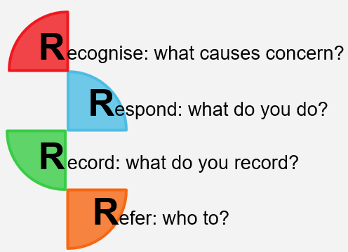
Section 5
Case Studies
Nominate a spokesperson to
summarise the discussion and
feedback to the group

Slide 33
Section 6
Awareness test

Slide 34


Review
Section 6
What makes safeguarding in the Church special?
Safeguarding is everyone’s responsibility
Recognise
Respond
What I need to know for my role(s) and responsibilities
Record
Refer

Slide 35
From the Chat…
Any unanswered questions?
Section 6

Slide 36
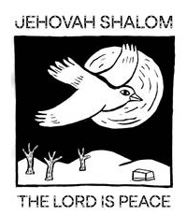
In the speaking and in the spaces
In the unknowing and in the silences
In the things untold or buried
Bring wisdom, Holy Spirit
Bring time, Creator
Bring the word,
beyond words
Taken from So What’s the Story? by
Barbara Glasson and Clive Marsh
(Methodist Publishing, 2019)
Image by Benji Spence

Slide 37


Section 6
Learning Log
Course Handbook
Find those policies!

Slide 38
Section 6
Thank you!
Creating Safer Space
Foundation Module
2020 Edition (online)
Certificates:
Pastoral Support:

