Slide 1
A gift of
Christmas

Slide 2
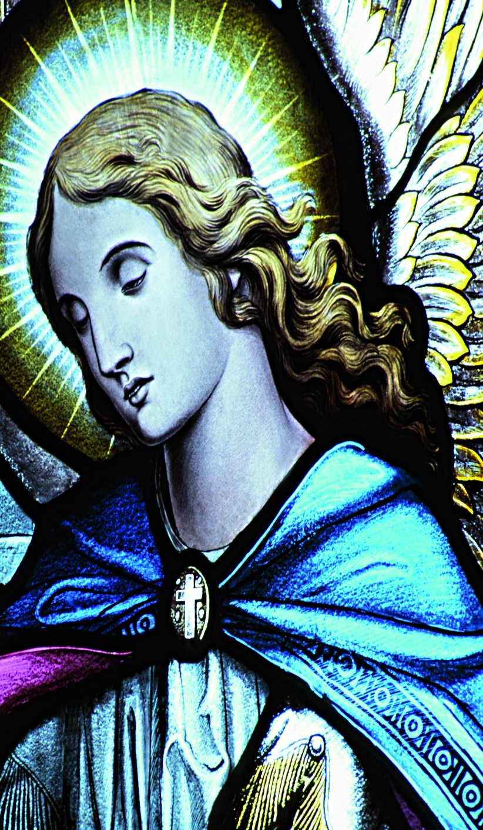
Do not be afraid...
...the angel Gabriel was sent by God to a town in Galilee called Nazareth, to a virgin engaged to a man whose name was Joseph, of the house of David.

Slide 3
Do not be afraid...
The virgin’s name was Mary. ...The angel said to her, ‘Do not be afraid, Mary, for you have found favour with God. And now, you will conceive in your womb and bear a son, and you will name him Jesus...

Slide 4
Do not be afraid...
...And Mary said, ‘My soul magnifies the Lord, and my spirit rejoices in God my Saviour...’
Luke 1:26-27, 30-31, 46-47 (NRSV)

Slide 5
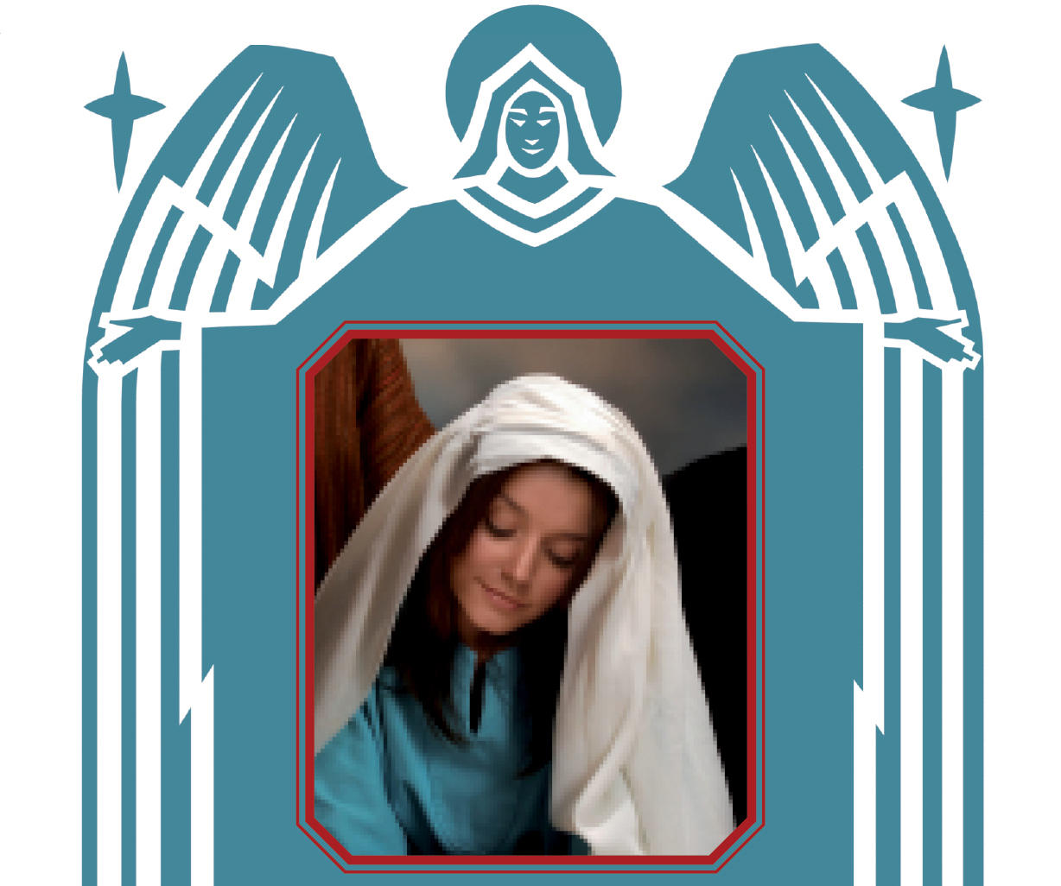
...and magnify his holy name

Slide 6
...and magnify his holy name
Then gentle Mary meekly bowed her head,
“To me be as it pleaseth God”, she said,

Slide 7
...and magnify his holy name
“My soul shall laud and magnify his holy name”
Sabine Baring-Gould
(1834-1924)

Slide 8
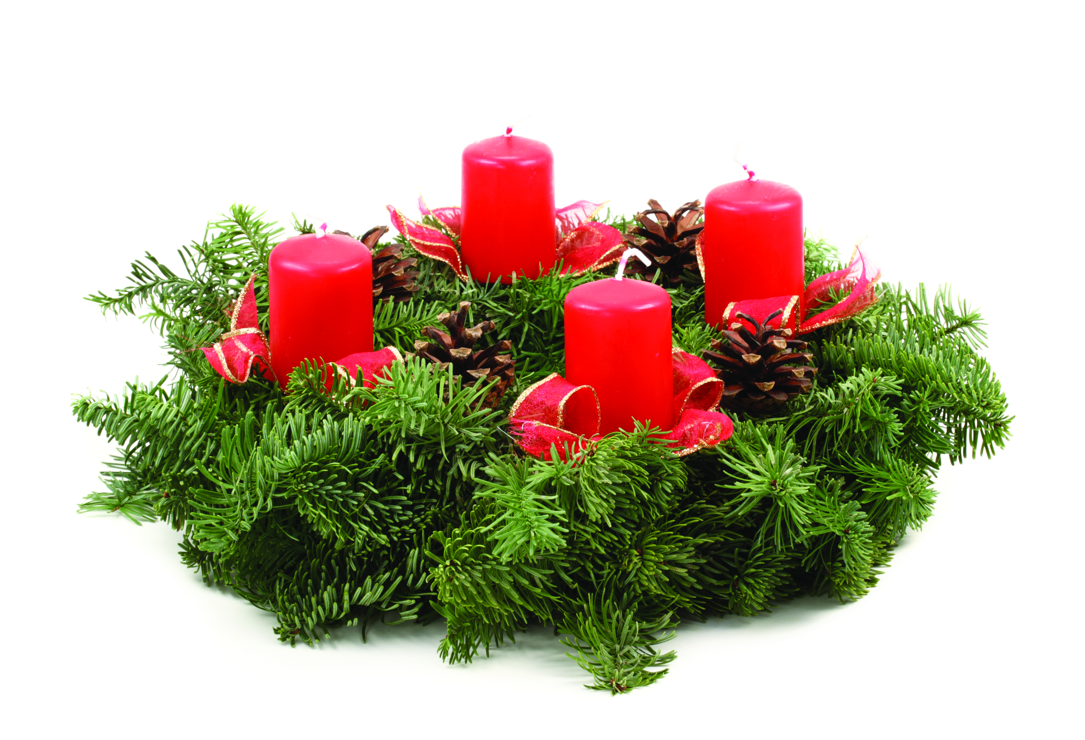
Preparing for Christmas
Advent, from the Latin ‘adventus’ which means ‘arrival’ or ‘coming’, is the period of waiting and preparation for Christmas. Many people mark this by using an Advent wreath, usually a circle of evergreen plants with four candles.

Slide 9
Preparing for Christmas
On the first Sunday of Advent, one candle is lit. An additional one is lit during each subsequent week until, by the last Sunday before Christmas, all four candles are alight. Some Advent
wreaths include a fifth, ‘Christ’
candle in the centre – usually a white one – which can be lit on Christmas Day.

Slide 10
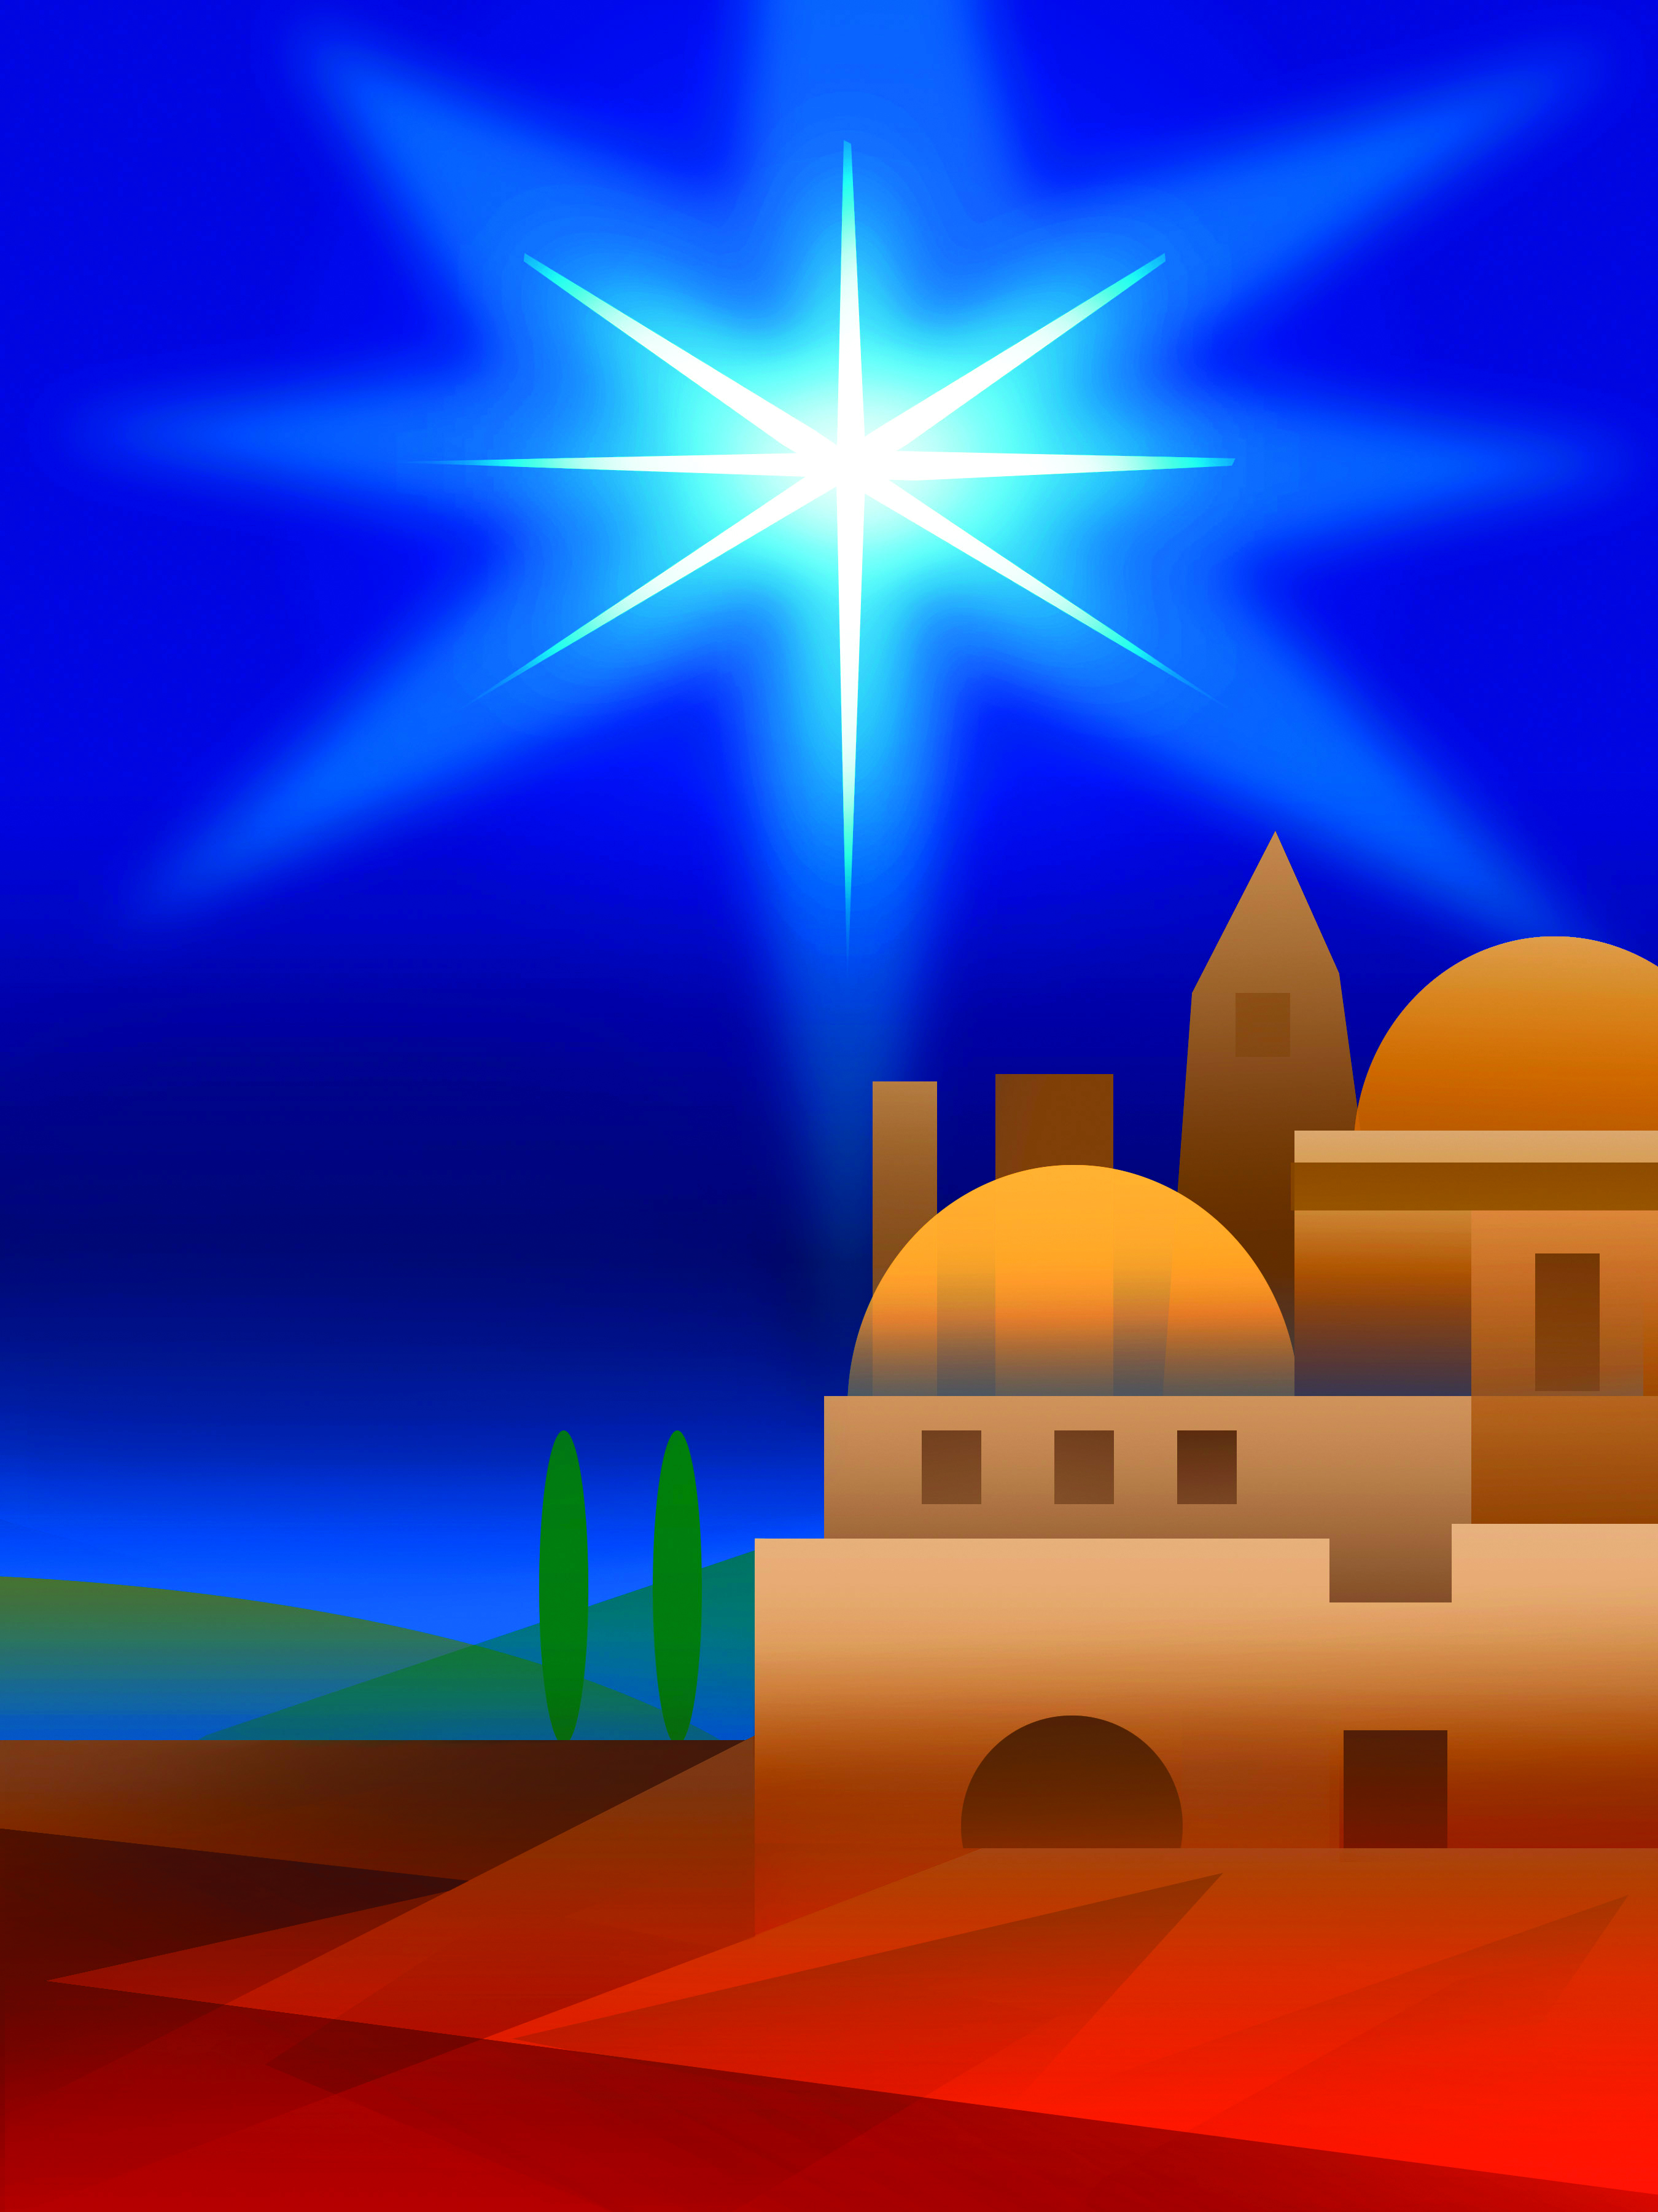
...a decree went out
In those days a decree went out from Emperor Augustus that all the world should be registered... All went to their own towns to be registered.

Slide 11
...a decree went out
Joseph also went from the town of Nazareth in Galilee to Judea, to the city of David called Bethlehem, because he was descended from the house and family of David.

Slide 12
...a decree went out
He went to be registered with Mary, to whom he was engaged and who was expecting a child.
Luke 2:1, 3-5 (NRSV)

Slide 13
...born for you and me
Well, in those days Caesar Augustus
issued a decree,
and so Mary went with her husband
where they had to be.

Slide 14
...born for you and me
There was nowhere else but a stable, where they both could sleep.
It was there that she had her baby,
born for you and me.
Mark and Helen Johnson
© 1994, 2006 & 2009, Out of the Ark Ltd,
Middx TW12 2HD. CCLI Song No. 1095398

Slide 15
King of all the world
It was on a starry night when the hills were bright,
earth lay sleeping, sleeping calm and still;

Slide 16
King of all the world
then in a cattle shed, in a manger bed,
a boy was born, King of all the world.

Slide 17
King of all the world
And all the angels sang for him,
the bells of heaven rang for him;
for a boy was born,
King of all the world.
Joy Webb
© Salvationist Publishing & Supplies Ltd (Admin by Song Solutions CopyCare www.songsolutions.org)

Slide 18
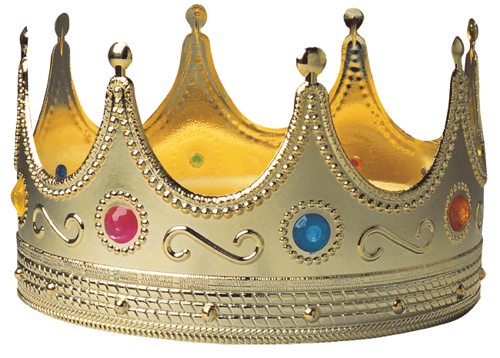
King of all the world
...the time came for her to deliver her child. And she gave birth to her firstborn son and wrapped him in bands of cloth, and laid him in a manger.
Luke 2:6-7 (NRSV)

Slide 19
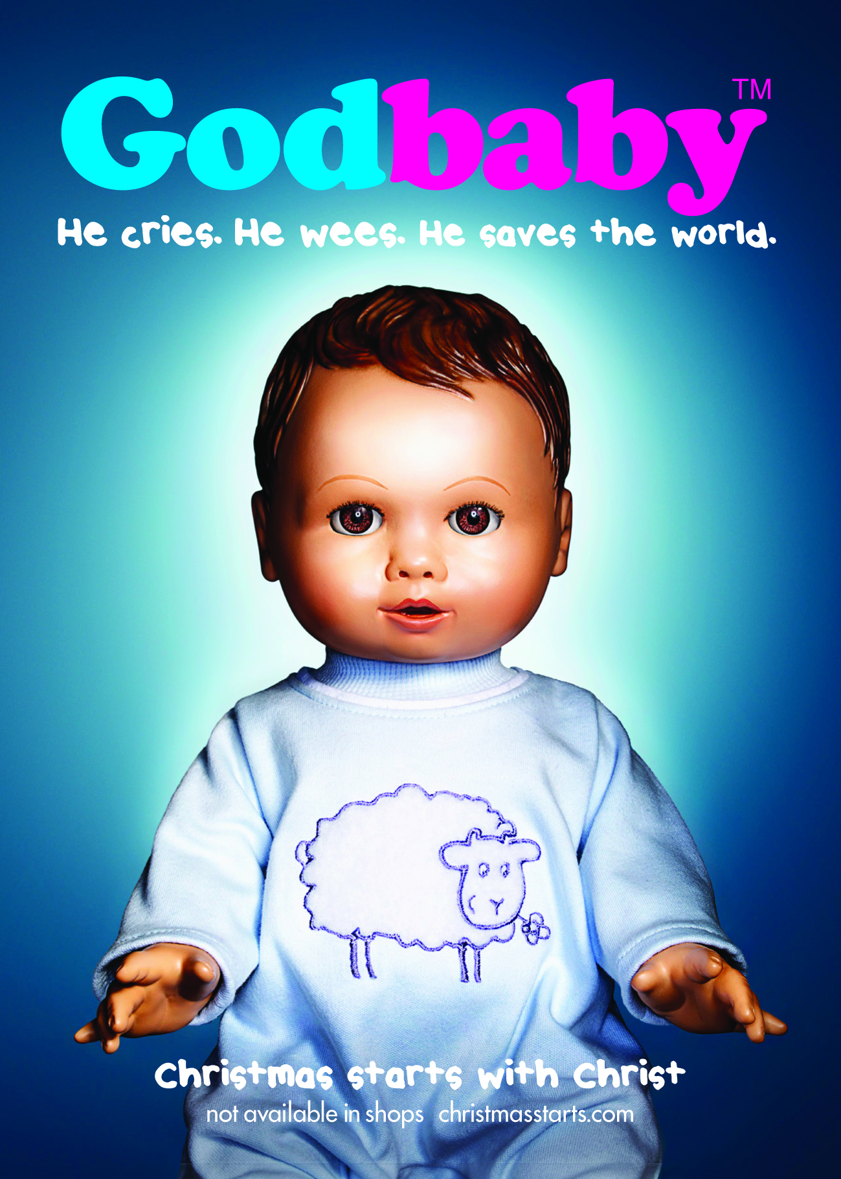

Slide 20
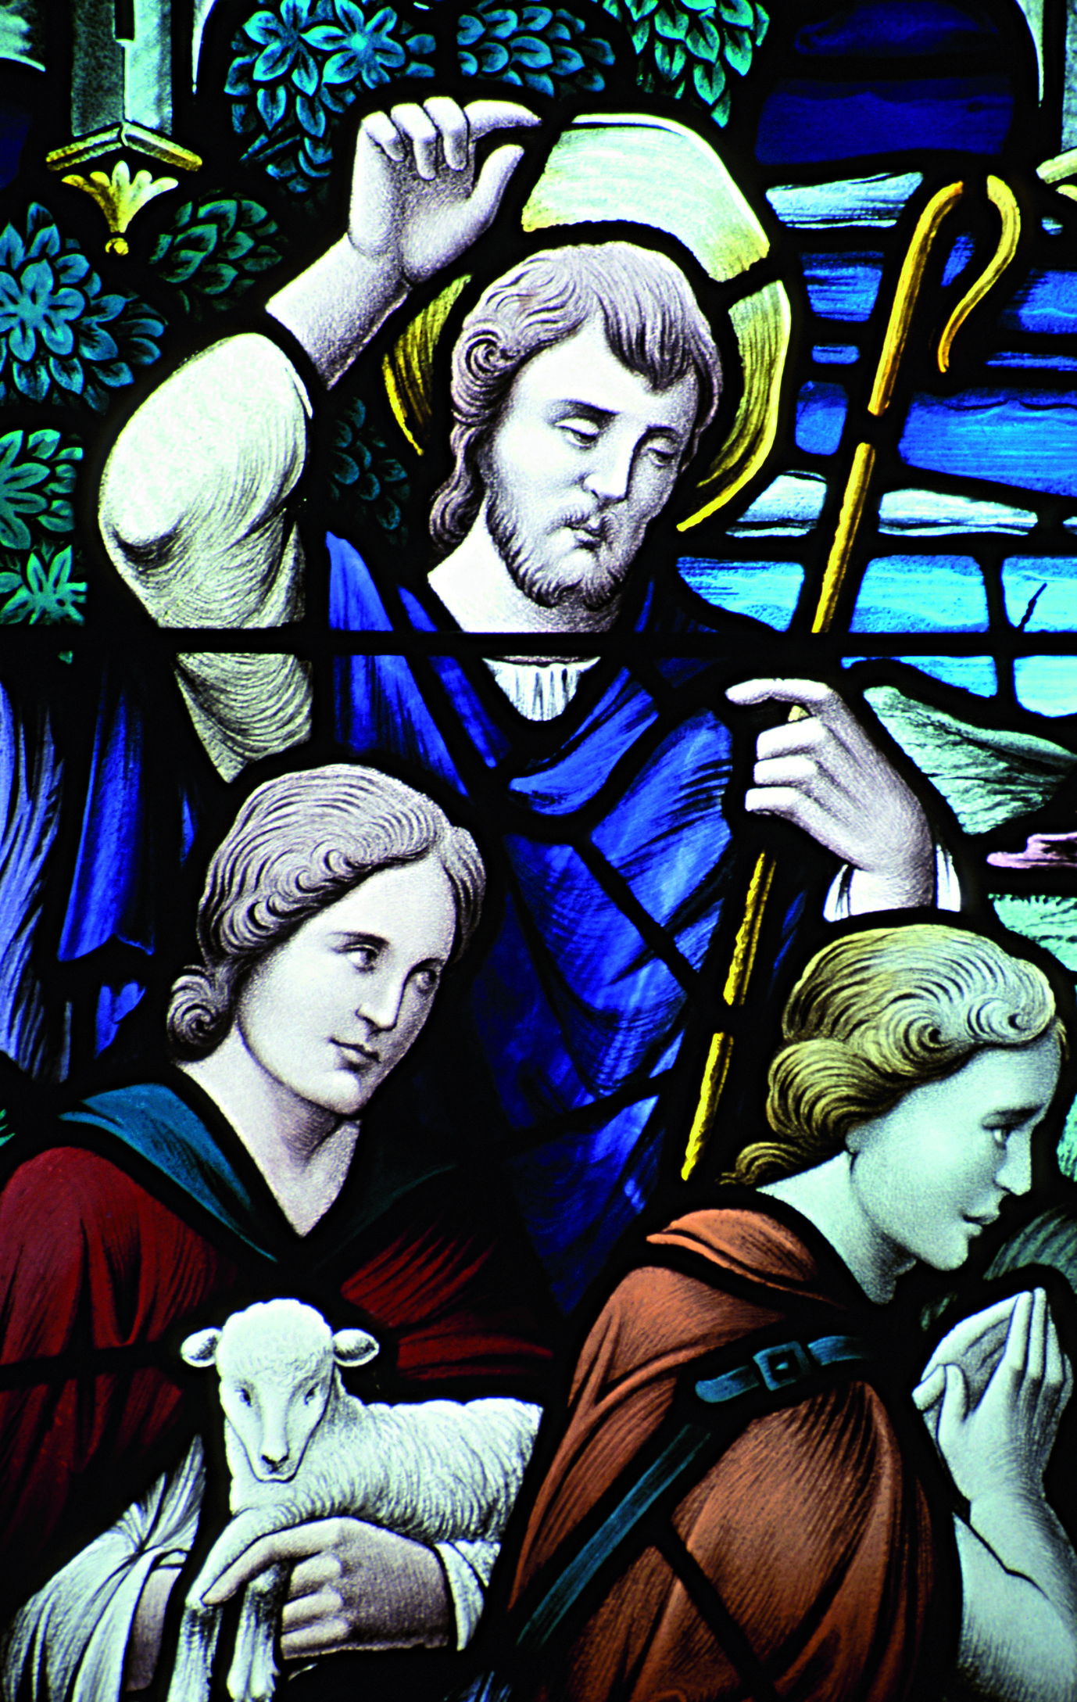
...proclaim the Messiah’s birth
Angels, from the realms of glory,
Wing your flight o'er all the earth;
Ye who sang creation's story,
Now proclaim Messiah's birth.

Slide 21
...proclaim the Messiah’s birth
Shepherds in the field abiding,
Watching o'er your flocks by night,
God with man is now residing,
Yonder shines the infant Light.
James Montgomery (1771-1854)

Slide 22
I am bringing you good news...

Slide 23
I am bringing you good news...
“In that region there were shepherds living in the fields,
keeping watch over their flock by night. Then an angel of the
Lord stood before them, and the glory of the Lord shone
around them.

Slide 24
I am bringing you good news...
... the angel said to them, ‘Do not be afraid; for see – I am bringing you good news of great joy for all the people: to you is born this day in the city of David a Saviour, who is the Messiah, the Lord. This will be a sign for you: you will find a child wrapped in bands of cloth and lying in a manger.’

Slide 25
I am bringing you good news...
And suddenly there was with the angel a multitude of the heavenly host, praising God and saying,
‘Glory to God in the highest heaven, and on earth peace
among those whom he favours!’”
Luke 2:8-14 (NRSV)

Slide 26
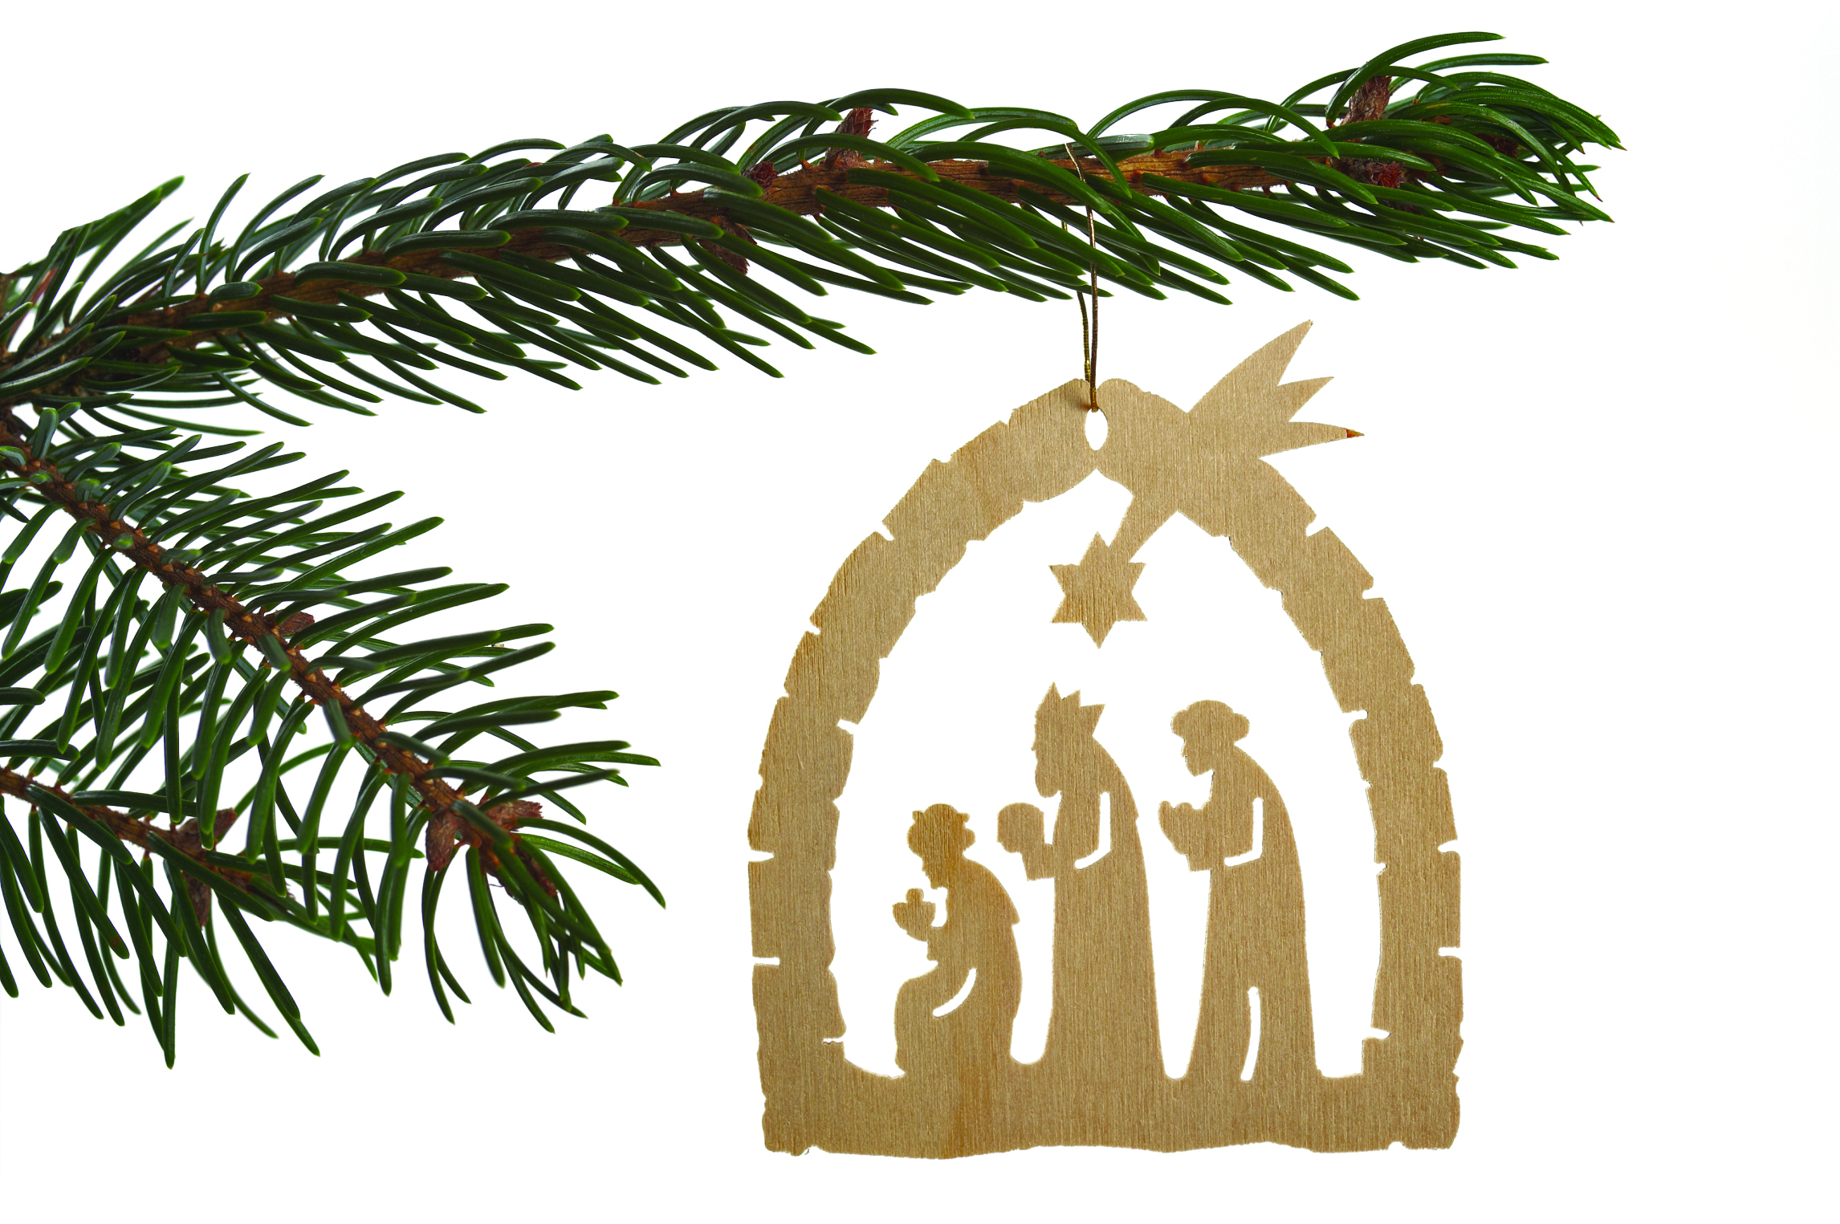
It led the way to Jesus
A special star, a special star
It led the way to Jesus.
A special star, a special star
Shone over where he lay.

Slide 27
It led the way to Jesus
A special star, a special star
It led three Kings to Jesus.
A special star, a special star
Led Kings to worship him.
Lynda Masson

Slide 28
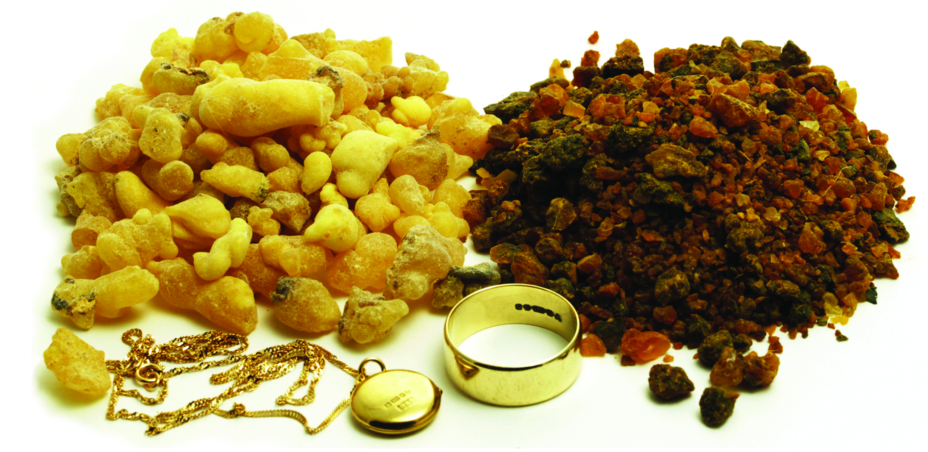
...they offered him gifts
“...wise men from the East came to Jerusalem, asking, ‘Where is the child who has been born king of the Jews?
For we observed his star at its rising, and have come to pay him homage.’

Slide 29
...they offered him gifts
... ahead of them, went the star ... until it stopped over the place where the child was. When they saw that the star had stopped, they were overwhelmed with joy. On entering the house, they saw the child with Mary his mother;

Slide 30
...they offered him gifts
and they knelt down and paid him homage. Then, opening their treasure-chests, they offered him gifts of gold, frankincense, and myrrh.”
Matthew 2:1-2, 9-11 (NRSV)

Slide 31
You choose us today
Almighty God creator of the universe, all powerful and majestic, you chose Mary to share in your rescue of the world, to have a baby who would save the world, to be the mother of your son who would teach the world to love..

Slide 32
You choose us today
You choose us today - to make space for your love in our lives, to nurture love and to let love go and bring healing. Give us the courage and grace of a young mother as we share in your work of love and creation. Amen. Mark Wakelin, President of the Methodist Conference 2012/13

Slide 33
Greetings from around the world

Slide 36
A gift of Christmas

